Slide 1
Analytics FOR BUSINESS Intelligence
Fall 2021
Nuria Diaz-Tena
Notes:
Attendance and Seating

Slide 2
To Review:
Inference
What is a confidence interval?
What is a test of significance?
Use and Abuse of Statistical Inference
Two-Way Tables and the Chi-Square test
Homework # 2 Review
Helper1
Helper 2
Helper 3
Linear Regression Summary
Helper 4

Slide 3
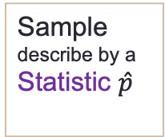
Statistical inference draws conclusions about a population on the basis of data about a sample.
Numbers that describe a population are parameters. To estimate a population parameter, choose a sample from the population and use a statistic, a number calculated from the sample, as your estimate.
To answers questions such as:
“What percent of employed women have a college degree?’’
“What is the mean survival time for patients with this type of cancer?’’
Population
describe by a
Parameter p
Sample
describe by a
Statistic $\hat{p}$

Slide 4
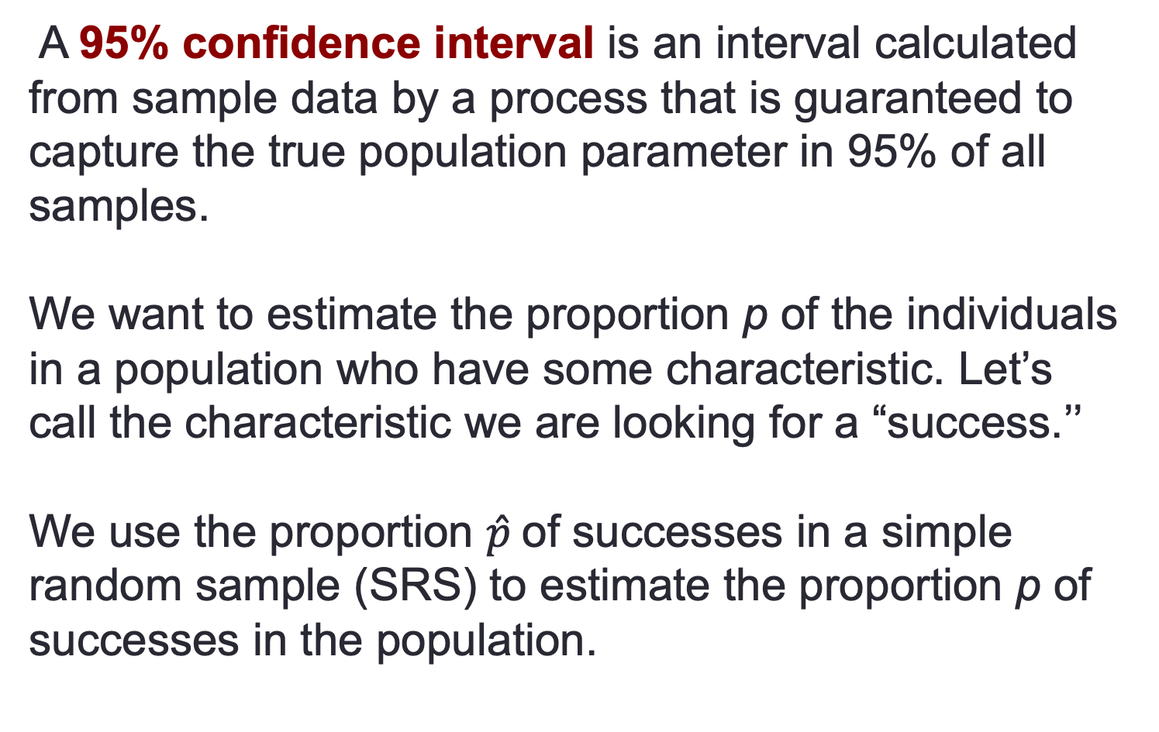
Confidence Interval of a Proportion
A 95% confidence interval is an interval calculated from sample data by a process that is guaranteed to capture the true population parameter in 95% of all samples.
We want to estimate the proportion p of the individuals in a population who have some characteristic. Let’s call the characteristic we are looking for a “success.’’
We use the proportion $\hat{p}$of successes in a simple random sample (SRS) to estimate the proportion p of successes in the population.

Slide 5
Samples have variability
How good is the statistic $\hat{p}$ as an estimate of the parameter $p$? To find out, we ask, “What would happen if we took many samples?’’
We know that $\hat{p}$ would vary from sample to sample.
This sampling variability has a clear pattern in the long run, a pattern that is pretty well described by a Normal curve.

Slide 6
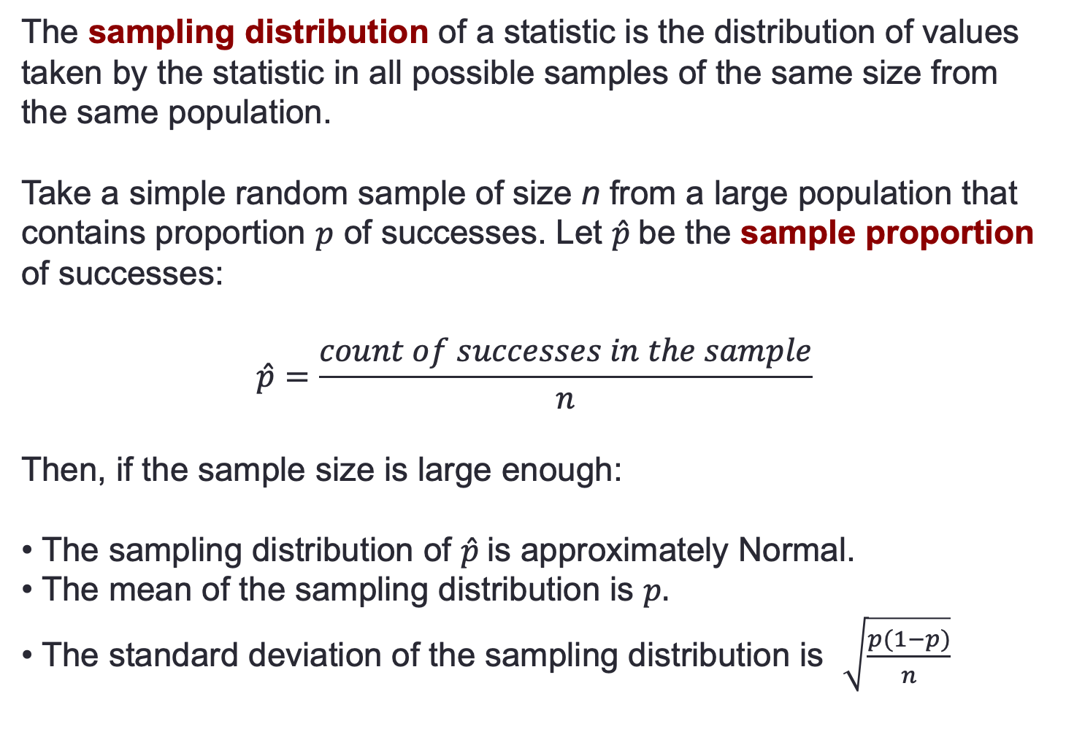
Sampling distribution of a sample proportion
The sampling distribution of a statistic is the distribution of values taken by the statistic in all possible samples of the same size from the same population.
Take a simple random sample of size n from a large population that contains proportion $p$ of successes. Let $\hat{p}$be the sample proportion of successes:
$$\hat{p}=\frac{count of successes in the sample}{n}$$
Then, if the sample size is large enough:
• The sampling distribution of $\hat{p}$is approximately Normal.
• The mean of the sampling distribution is $p.$
• The standard deviation of the sampling distribution is $\sqrt{\frac{p(1−p)}{n}}$

Slide 7
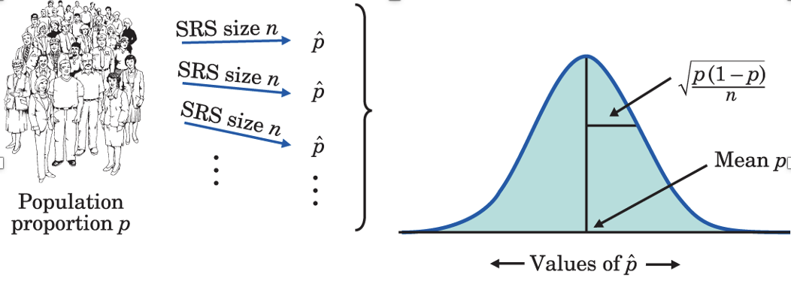
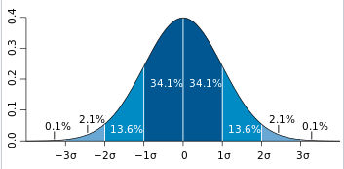
Normal Distribution
Sampling Distribution of a Sample Proportion
The standard deviation of the sampling distribution of a sample statistic is commonly referred to as the standard error.
Normal Distribution

Slide 8
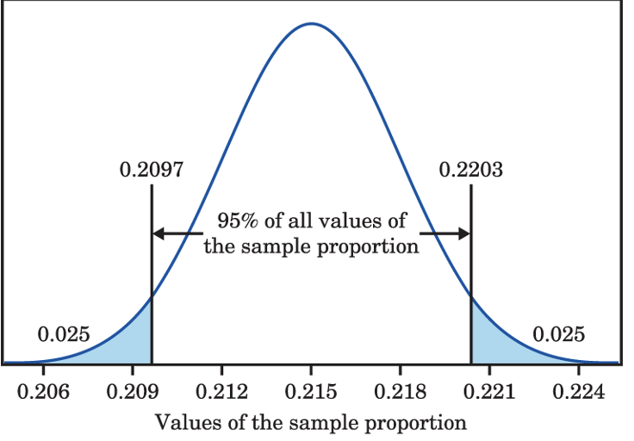
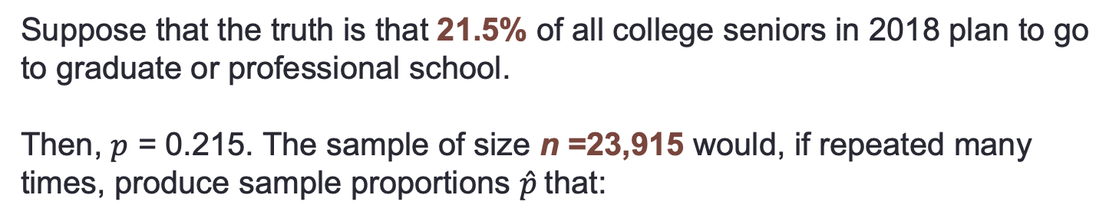
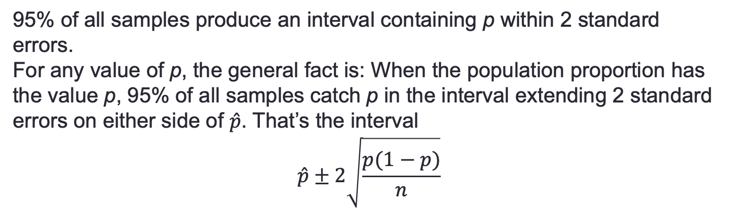
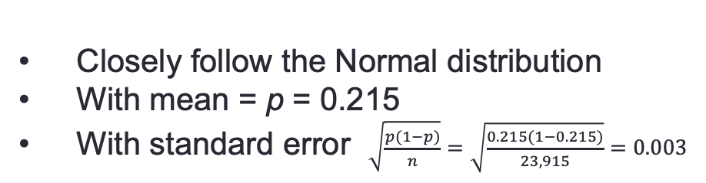
Example computing 95% CI
Suppose that the truth is that 21.5% of all college seniors in 2018 plan to go to graduate or professional school.
Then, $p$ = 0.215. The sample of size n =23,915 would, if repeated many times, produce sample proportions $\hat{p}$that:
Closely follow the Normal distribution
With mean = p = 0.215
With standard error $\sqrt{\frac{p(1−p)}{n}}=\sqrt{\frac{0.215(1−0.215)}{23,915}}=0.003$
95% of all samples produce an interval containing p within 2 standard errors.
For any value of p, the general fact is: When the population proportion has the value p, 95% of all samples catch p in the interval extending 2 standard errors on either side of $\hat{p}$. That’s the interval
$$\hat{p}±2\sqrt{\frac{p(1−p)}{n}}$$

Slide 9
Use Statistic when Parameter is Unknown
Is this the interval we want? Not quite! We don’t know p to substitute into the standard error formula, so we’ll use the best guess for it, $\hat{p}$ instead.
Choose a simple random sample (SRS) of size n from a large population that contains an unknown proportion p of successes. Call the proportion of successes in this sample $\hat{p}$. An approximate 95% confidence interval for the parameter p is
$$\hat{p}±2\sqrt{\frac{\hat{p}(1−\hat{p})}{n}}$$

Slide 10

Case Study Fruit and vegetables: What Is the Question?
According to the Centers for Disease Control and Prevention (CDC), adults who engage in less than 30 minutes of moderate physical exercise per day should consume one and a half to two cups of fruits per day and two to three cups of vegetables per day. Are adults meeting these recommendations?

Slide 11
Case Study Fruit and Vegetables: Sample Design
The Behavioral Risk Factor Surveillance System (BRFSS) is an ongoing, state-based, random digit-dialed telephone survey of adults who are at least 18 years of age.
The BRFSS is the world’s largest ongoing telephone health survey system.
Data are gathered monthly from all 50 states, the District of Columbia (DC), Puerto Rico, the U.S. Virgin Islands, and Guam.
Survey respondents were asked to think about the previous month and to indicate how many times per day, week, or month they consumed whole fruit, 100% fruit juice, dried beans, dark green vegetables, orange vegetables, and other vegetables.
Although close to 500,000 individuals were originally contacted to be a part of the survey in 2013, 118,193 respondents were excluded from analysis because they either resided in other countries, had missing responses to one or more questions, or had implausible reports of fruit and vegetable consumption.
Type of Survey
Frequency
Geography
Data collected
Sample Size
Ineligible subjects
Nonresponse
Response Error

Slide 12
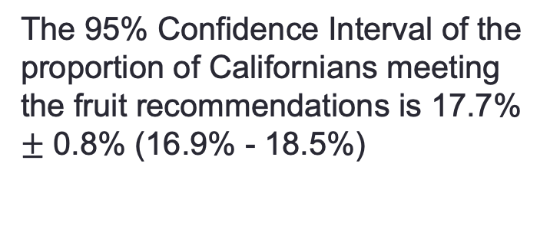
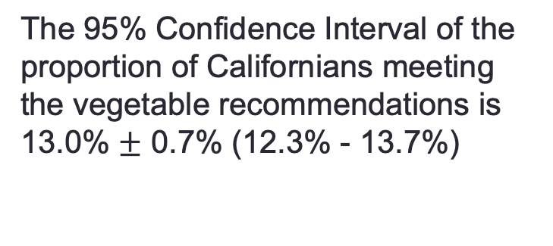
Case Study Fruit and Vegetables: Results
The results reported in the 2013 BRFSS are based on the final sample of 373,580 adults.
Across the states, results varied. The state with the largest number of survey respondents reporting meeting the daily fruit and vegetable intake recommendations was California.
17.7% of the 9,011 California residents who were surveyed met the daily fruit intake recommendations and 13% met the daily vegetable intake recommendations.
We know these numbers won’t be exactly right for the entire population of adults in California, but are they close?
The 95% Confidence Interval of the proportion of Californians meeting the fruit recommendations is 17.7% $±$ 0.8% (16.9% - 18.5%)
The 95% Confidence Interval of the proportion of Californians meeting the vegetable recommendations is 13.0% $±$ 0.7% (12.3% - 13.7%)

Slide 13
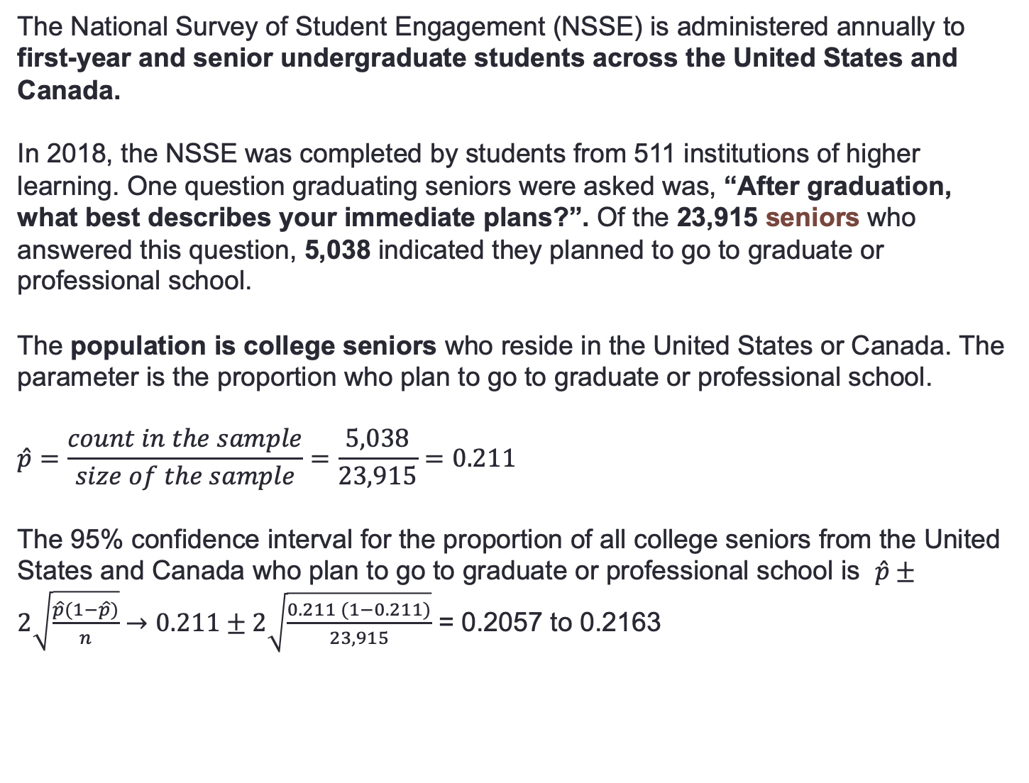
Example Graduation Plans: 95% CI
The National Survey of Student Engagement (NSSE) is administered annually to first-year and senior undergraduate students across the United States and Canada.
In 2018, the NSSE was completed by students from 511 institutions of higher learning. One question graduating seniors were asked was, “After graduation, what best describes your immediate plans?”. Of the 23,915 seniors who answered this question, 5,038 indicated they planned to go to graduate or professional school.
The population is college seniors who reside in the United States or Canada. The parameter is the proportion who plan to go to graduate or professional school.
$$\hat{p}=\frac{count in the sample}{size of the sample}=\frac{5,038}{23,915}=0.211$$
The 95% confidence interval for the proportion of all college seniors from the United States and Canada who plan to go to graduate or professional school is $\hat{p}±2\sqrt{\frac{\hat{p}(1−\hat{p})}{n}}→0.211±2\sqrt{\frac{0.211 (1−0.211)}{23,915}}$ = 0.2057 to 0.2163

Slide 14
Example Graduation Plans: What does the 95% CI mean?
Interpret this result as follows: We got this interval by using a recipe that catches the true unknown population proportion in 95% of all samples.
The shorthand is that we are 95% confident that between 20.57% and 21.63% of all college seniors in the United States and Canada plan to go to graduate or professional school.

Slide 15
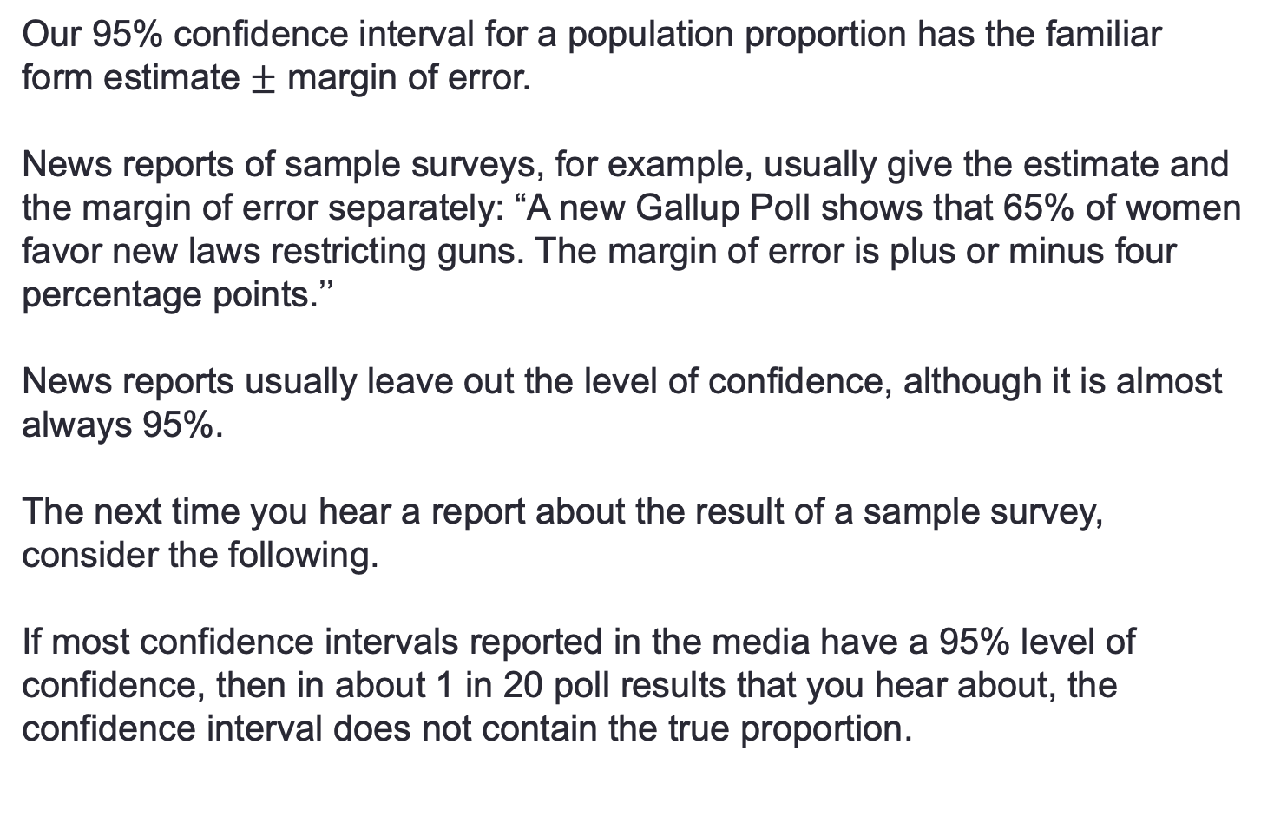
Confidence Intervals assume 95% if not specified
Our 95% confidence interval for a population proportion has the familiar form estimate $±$ margin of error.
News reports of sample surveys, for example, usually give the estimate and the margin of error separately: “A new Gallup Poll shows that 65% of women favor new laws restricting guns. The margin of error is plus or minus four percentage points.’’
News reports usually leave out the level of confidence, although it is almost always 95%.
The next time you hear a report about the result of a sample survey, consider the following.
If most confidence intervals reported in the media have a 95% level of confidence, then in about 1 in 20 poll results that you hear about, the confidence interval does not contain the true proportion.

Slide 16
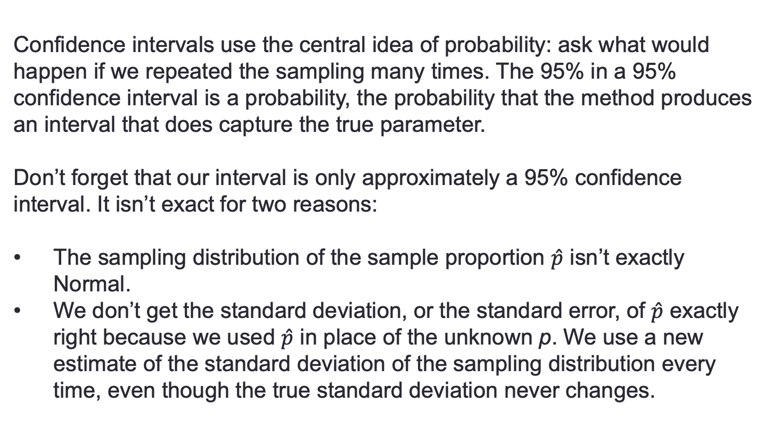
Assumptions on a 95% CI
Confidence intervals use the central idea of probability: ask what would happen if we repeated the sampling many times. The 95% in a 95% confidence interval is a probability, the probability that the method produces an interval that does capture the true parameter.
Don’t forget that our interval is only approximately a 95% confidence interval. It isn’t exact for two reasons:
The sampling distribution of the sample proportion $\hat{p}$ isn’t exactly Normal.
We don’t get the standard deviation, or the standard error, of $\hat{p}$ exactly right because we used $\hat{p}$ in place of the unknown p. We use a new estimate of the standard deviation of the sampling distribution every time, even though the true standard deviation never changes.

Slide 17
Improving Confidence Intervals
Both of these difficulties go away as the sample size n gets larger. So, our recipe is good only for large samples.
We used the 95 part of the 68–95–99.7 rule to get a 95% confidence interval for the population proportion.
Suppose you want to be 99% confident. For that, we need to mark off the central 99% of a Normal distribution.
For any probability C between 0 and 1, there is a number z* such that any Normal distribution has probability C within z* standard deviations of the mean.

Slide 18
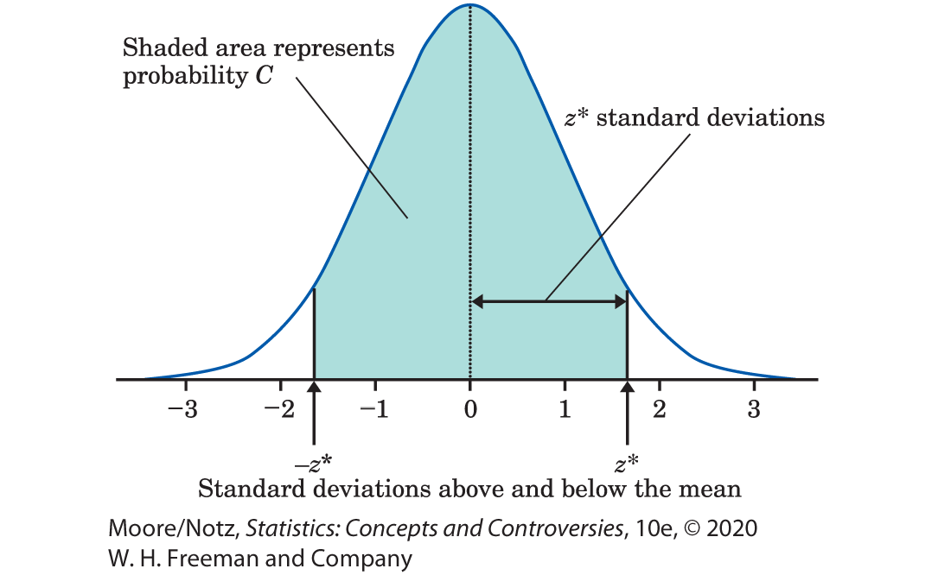
More on Confidence Intervals for a Population Proportion (optional) 2

Slide 19
More on Confidence Intervals for a Population Proportion (optional) 3
The Ttable gives the numbers z* for various choices of C. For convenience, the table gives C as a confidence level in percent. The numbers z* are called critical values of the Normal distributions.
=NORMINV(0.975,0,1). Result: 1.96
=NORM.INV(0.975,0,1)
=NORM.S.INV(0.975)
Confidence Level C | Critical value z*
50% | 0.67
60% | 0.84
70% | 1.04
80% | 1.28
90 | 1.64
95% | 1.96
99% | 2.58
99.9% | 3.29

Slide 20
Generalizing Confidence Intervals for a Population Proportion
Choose an SRS of size n from a population of individuals of which proportion p are successes. The proportion of successes in the sample is $\hat{p}$. When n is large, an approximate level C confidence interval for p is where z* is the critical value for probability C from Table 21.1.
$$\hat{p}±z^{∗}\sqrt{\frac{\hat{p}(1−\hat{p})}{n}}$$

Slide 21
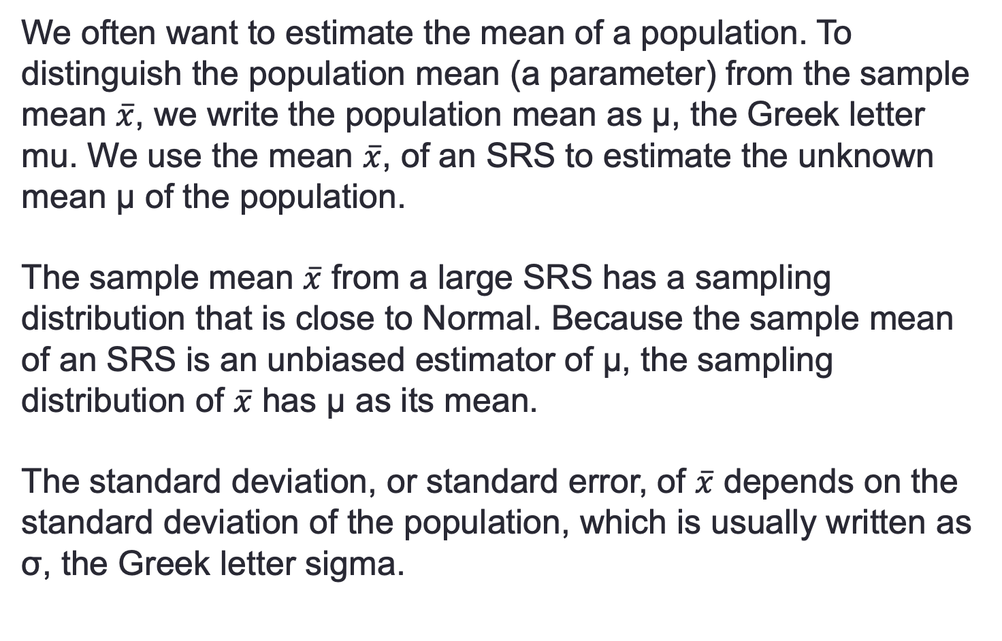
The Sampling Distribution of a Sample Mean
We often want to estimate the mean of a population. To distinguish the population mean (a parameter) from the sample mean $\overline{x}$, we write the population mean as µ, the Greek letter mu. We use the mean $\overline{x}$, of an SRS to estimate the unknown mean µ of the population.
The sample mean $\overline{x}$ from a large SRS has a sampling distribution that is close to Normal. Because the sample mean of an SRS is an unbiased estimator of µ, the sampling distribution of $\overline{x}$ has µ as its mean.
The standard deviation, or standard error, of $\overline{x}$ depends on the standard deviation of the population, which is usually written as σ, the Greek letter sigma.

Slide 22
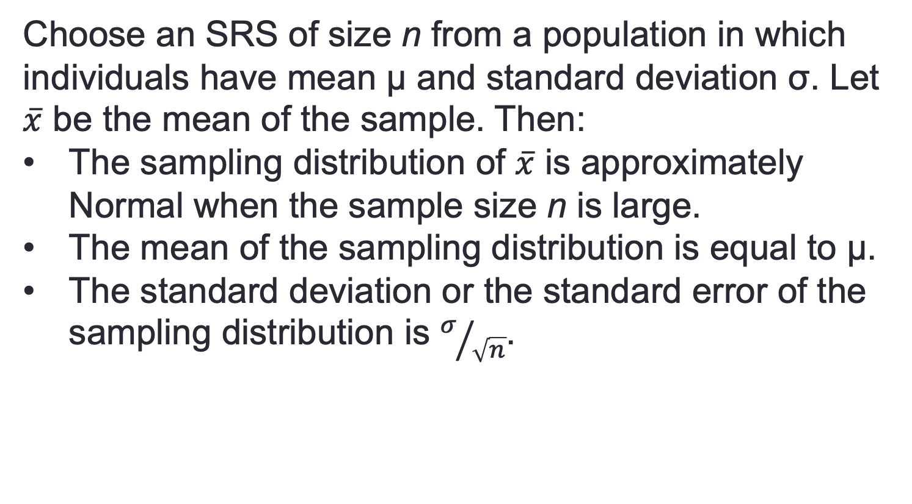
Computing the standard error of the mean
Choose an SRS of size n from a population in which individuals have mean µ and standard deviation σ. Let $\overline{x}$ be the mean of the sample. Then:
The sampling distribution of $\overline{x}$ is approximately Normal when the sample size n is large.
The mean of the sampling distribution is equal to µ.
The standard deviation or the standard error of the sampling distribution is $σ/{\sqrt{n}}$.

Slide 23
The SE of the mean is smaller thant he SE of the distribution
It isn’t surprising that the values that $\overline{x}$ takes in many samples are centered at the true mean µ of the population. That’s the lack of bias in random sampling. The other two facts about the sampling distribution make precise two very important properties of the sample mean $\overline{x}$:
• The mean of a number of observations is less variable than individual observations.
• The distribution of a mean of a number of observations is more Normal than the distribution of individual observations.

Slide 24
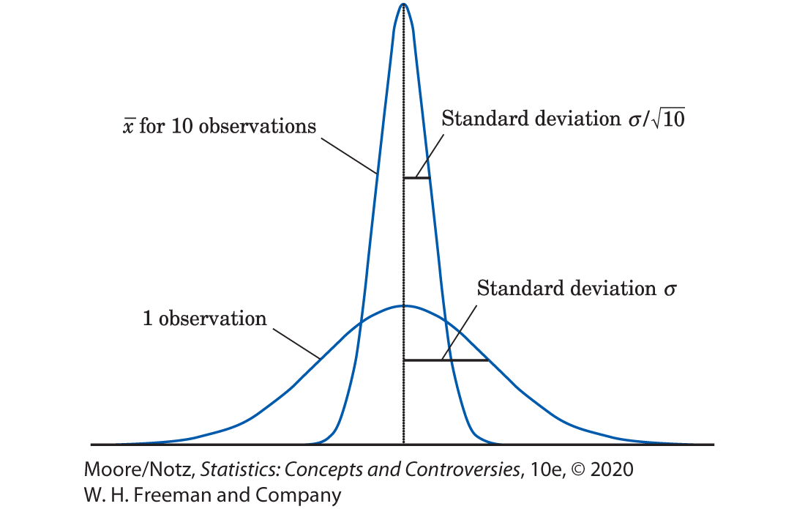
The Sampling Distribution of a Sample Mean
The figure compares the distribution of a single observation with the distribution of the mean of 10 observations.
Both have the same center, but the distribution of the sample mean is less spread out.

Slide 25
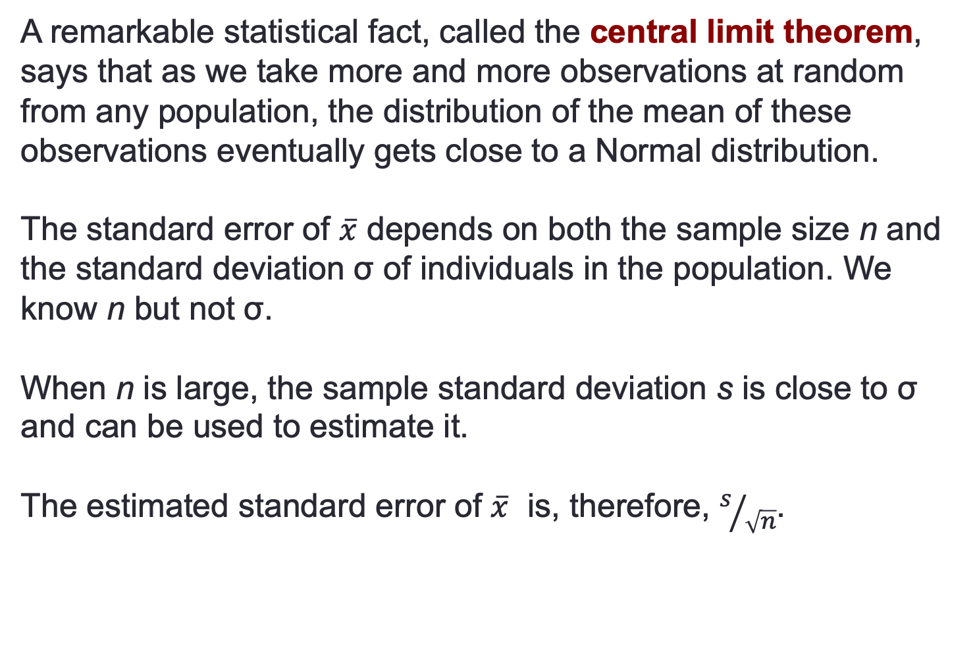
The Central Limit Theorem
A remarkable statistical fact, called the central limit theorem, says that as we take more and more observations at random from any population, the distribution of the mean of these observations eventually gets close to a Normal distribution.
The standard error of $\overline{x}$ depends on both the sample size n and the standard deviation σ of individuals in the population. We know n but not σ.
When n is large, the sample standard deviation s is close to σ and can be used to estimate it.
The estimated standard error of $\overline{x}$ is, therefore, $s/{\sqrt{n}}$.

Slide 26
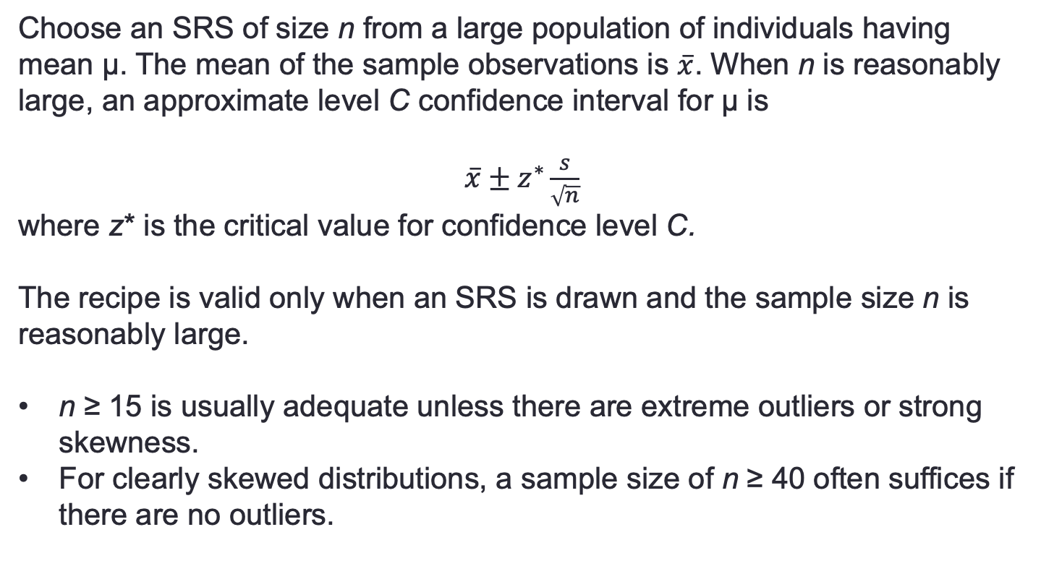
Confidence interval for a population mean
Choose an SRS of size n from a large population of individuals having mean µ. The mean of the sample observations is $\overline{x}$. When n is reasonably large, an approximate level C confidence interval for µ is
$\overline{x}±z^{∗}\frac{s}{\sqrt{n}}$
where z* is the critical value for confidence level C.
The recipe is valid only when an SRS is drawn and the sample size n is reasonably large.
n ≥ 15 is usually adequate unless there are extreme outliers or strong skewness.
For clearly skewed distributions, a sample size of n ≥ 40 often suffices if there are no outliers.

Slide 27
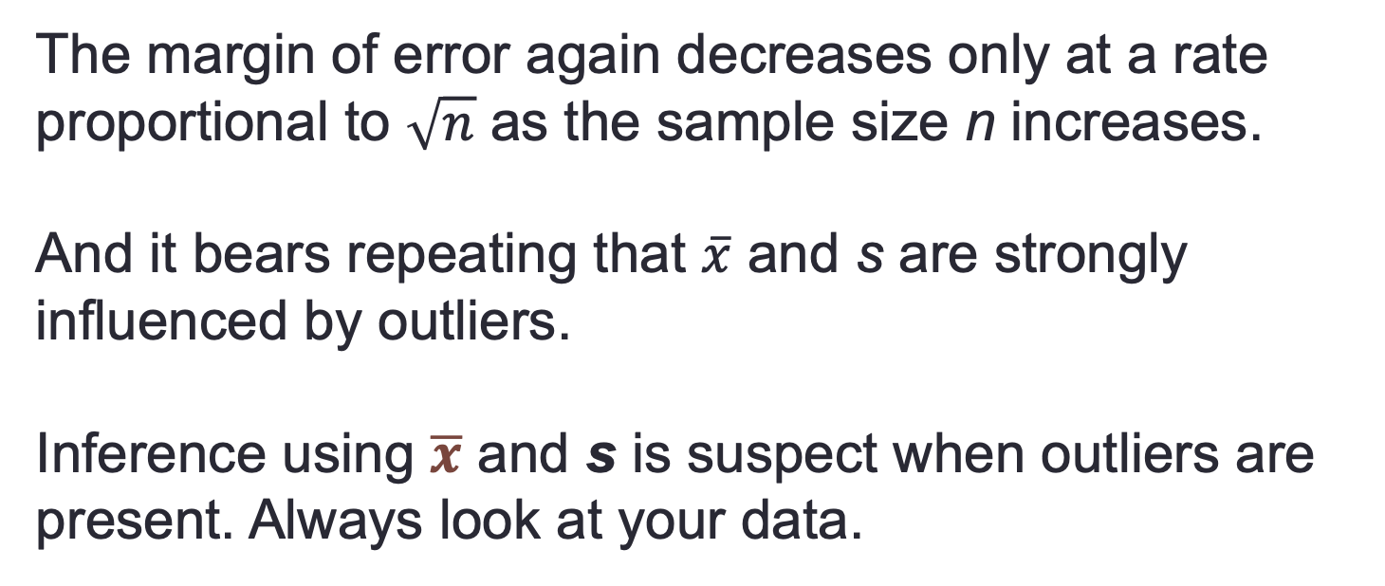
Always check the distributions
The margin of error again decreases only at a rate proportional to $\sqrt{n}$ as the sample size n increases.
And it bears repeating that $\overline{x}$ and s are strongly influenced by outliers.
Inference using $\overline{x}$ and s is suspect when outliers are present. Always look at your data.

Slide 28
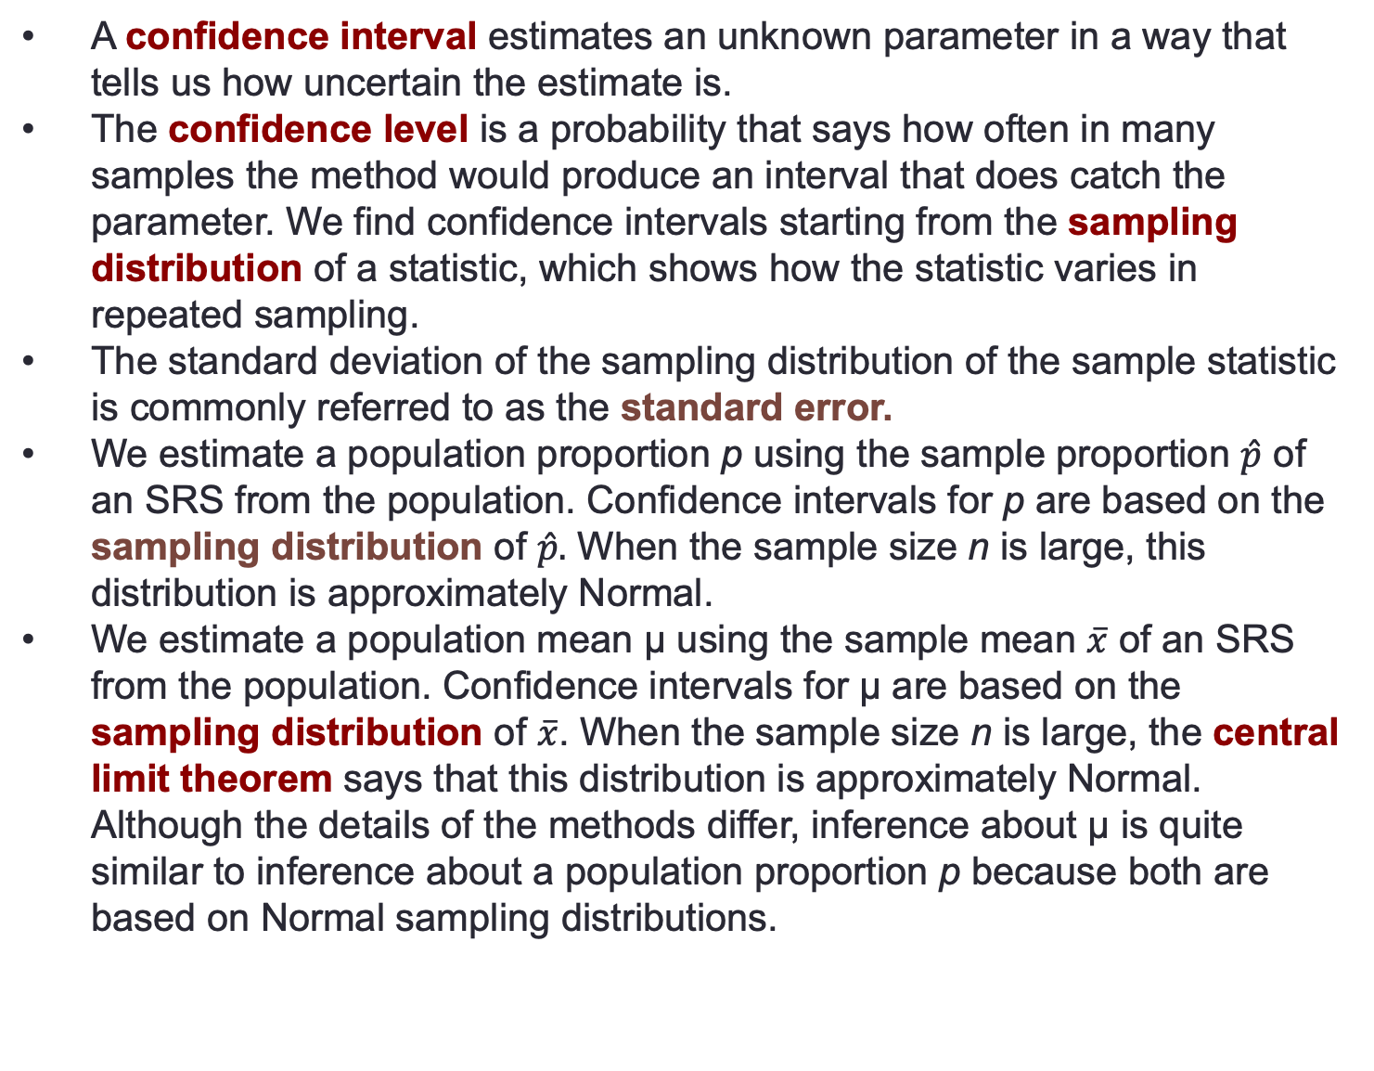
Summary
A confidence interval estimates an unknown parameter in a way that tells us how uncertain the estimate is.
The confidence level is a probability that says how often in many samples the method would produce an interval that does catch the parameter. We find confidence intervals starting from the sampling distribution of a statistic, which shows how the statistic varies in repeated sampling.
The standard deviation of the sampling distribution of the sample statistic is commonly referred to as the standard error.
We estimate a population proportion p using the sample proportion $\hat{p}$ of an SRS from the population. Confidence intervals for p are based on the sampling distribution of $\hat{p}.$ When the sample size n is large, this distribution is approximately Normal.
We estimate a population mean µ using the sample mean $\overline{x}$ of an SRS from the population. Confidence intervals for µ are based on the sampling distribution of $\overline{x}$. When the sample size n is large, the central limit theorem says that this distribution is approximately Normal. Although the details of the methods differ, inference about µ is quite similar to inference about a population proportion p because both are based on Normal sampling distributions.

Slide 29
To Review:
Inference
What is a confidence interval?
What is a test of significance?
Use and Abuse of Statistical Inference
Two-Way Tables and the Chi-Square test
Homework # 2 Review
Helper1
Helper 2
Helper 3
Linear Regression Summary
Helper 4

Slide 30


Is what you are not claiming TRUE?
“Show me,’’ you say.
“Aha,’’ you conclude, “if he makes 80%, he would almost never make as few as 8 of 20 (40%). So I don’t believe his claim.’’
The local hot-shot playground basketball player claims to make 80% of his free throws.
He shoots 20 free throws and makes 8 of them.
That’s the reasoning of statistical tests of significance at the playground level: an outcome that is very unlikely if a claim is true is good evidence that the claim is not true.
Statistical inference uses data from a sample to draw conclusions about a population.

Slide 31
A statistical test says, “If we took many samples and the claim were true, we would rarely get a result like this.’’
Statistical tests ask if sample data give good evidence against a claim.
To get a numerical measure of how strong the sample evidence is, replace the vague term rarely with a probability.

Slide 32
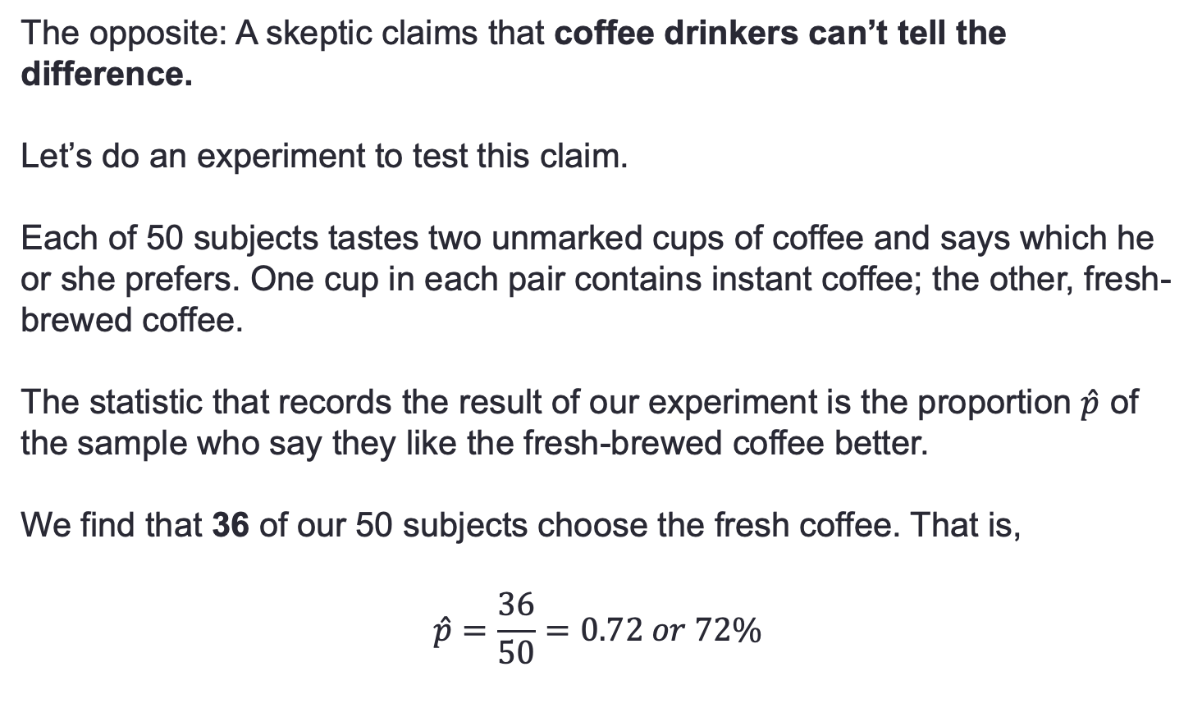
Example Coffee: Coffee drinkers prefer fresh-brewed coffee to instant coffee
The opposite: A skeptic claims that coffee drinkers can’t tell the difference.
Let’s do an experiment to test this claim.
Each of 50 subjects tastes two unmarked cups of coffee and says which he or she prefers. One cup in each pair contains instant coffee; the other, fresh-brewed coffee.
The statistic that records the result of our experiment is the proportion $\hat{p}$ of the sample who say they like the fresh-brewed coffee better.
We find that 36 of our 50 subjects choose the fresh coffee. That is,
$$\hat{p}=\frac{36}{50}=0.72 or 72\%$$

Slide 33
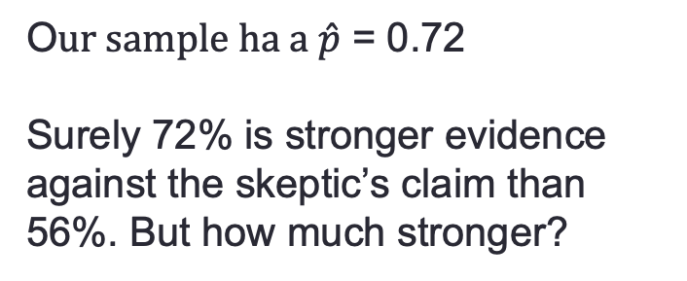
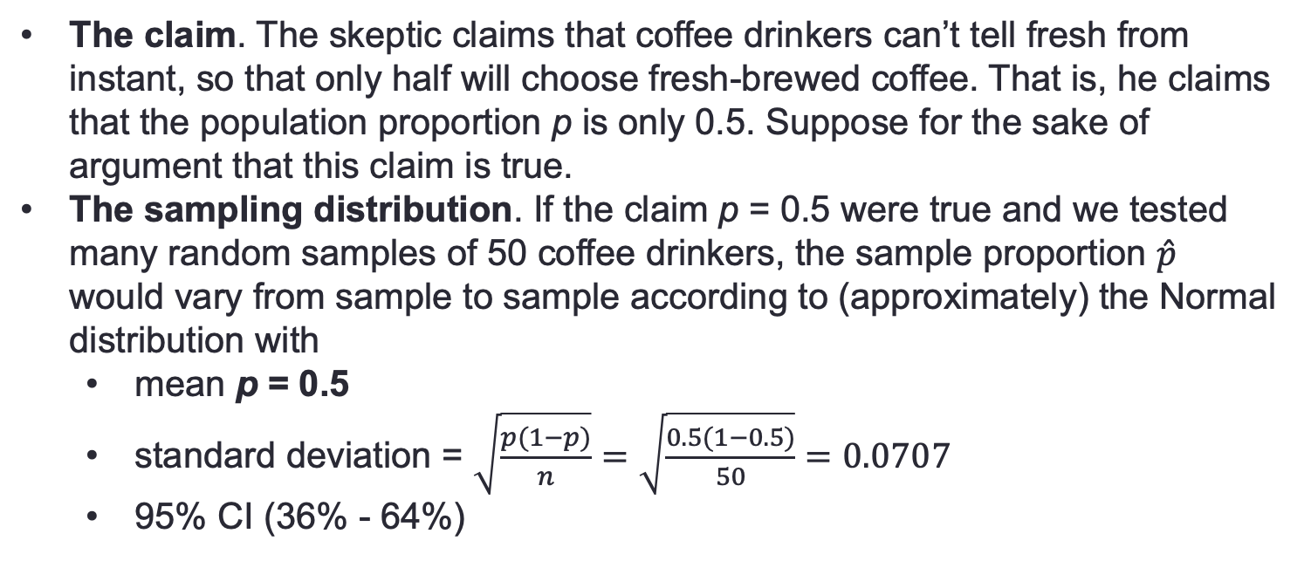
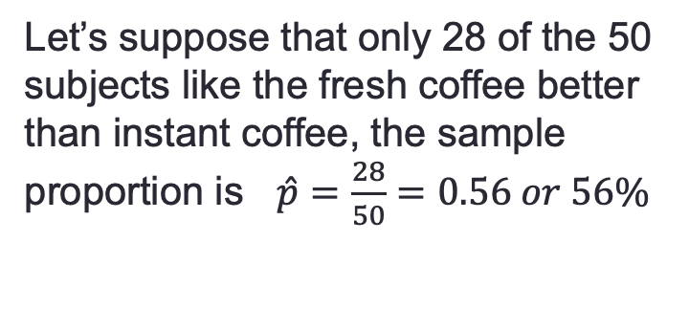
Example Coffee: Is 72% large enough to disprove the skeptic claim?
O$ur sample ha a \hat{p}$ = 0.72
Surely 72% is stronger evidence against the skeptic’s claim than 56%. But how much stronger?
Let’s suppose that only 28 of the 50 subjects like the fresh coffee better than instant coffee, the sample proportion is $\hat{p}=\frac{28}{50}=0.56 or 56\%$
The claim. The skeptic claims that coffee drinkers can’t tell fresh from instant, so that only half will choose fresh-brewed coffee. That is, he claims that the population proportion p is only 0.5. Suppose for the sake of argument that this claim is true.
The sampling distribution. If the claim p = 0.5 were true and we tested many random samples of 50 coffee drinkers, the sample proportion $\hat{p}$ would vary from sample to sample according to (approximately) the Normal distribution with
mean p = 0.5
standard deviation = $\sqrt{\frac{p(1−p)}{n}}=\sqrt{\frac{0.5(1−0.5)}{50}}=0.0707$
95% CI (36% - 64%)

Slide 34
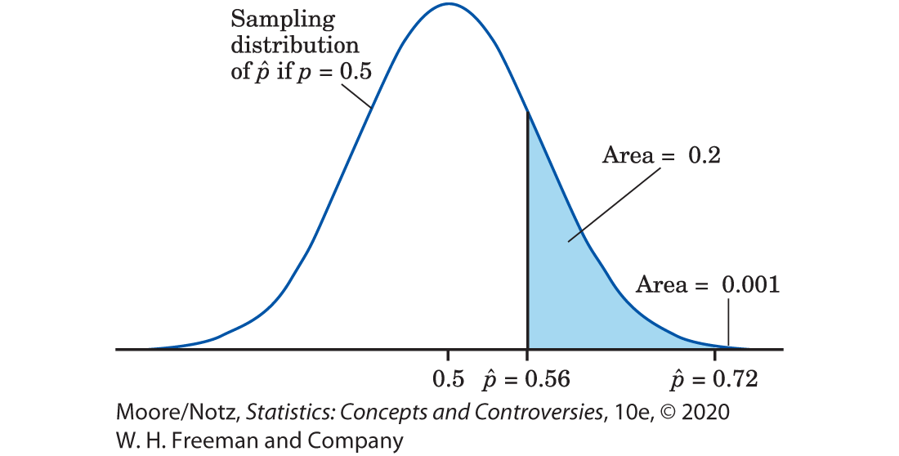
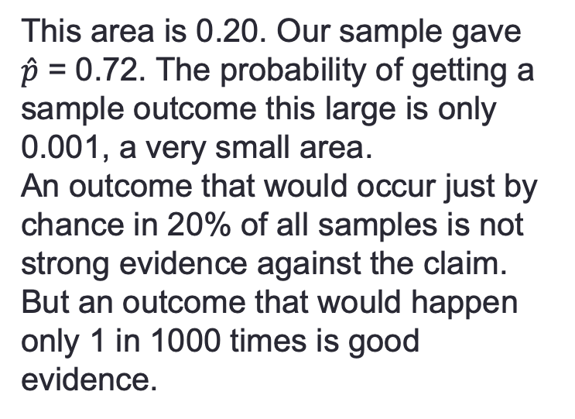
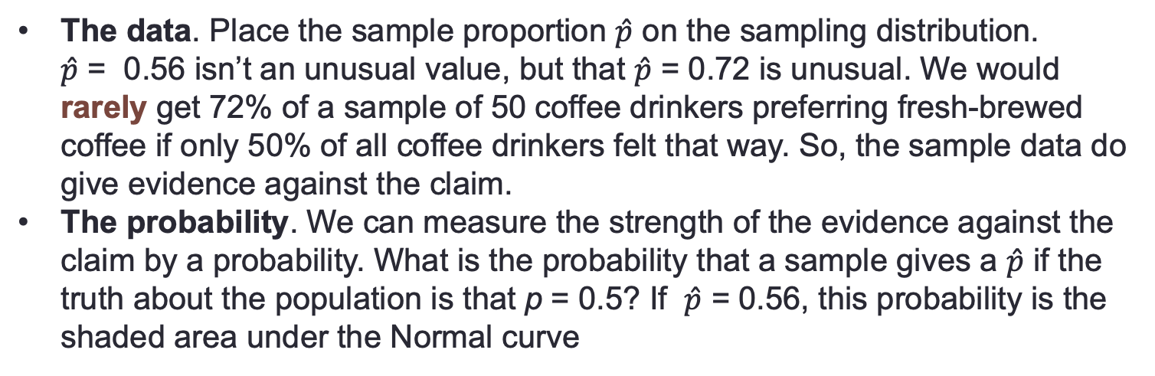
Example Coffee: Visualizing the probability
The data. Place the sample proportion $\hat{p}$ on the sampling distribution. $\hat{p}$ = 0.56 isn’t an unusual value, but that $\hat{p}$ = 0.72 is unusual. We would rarely get 72% of a sample of 50 coffee drinkers preferring fresh-brewed coffee if only 50% of all coffee drinkers felt that way. So, the sample data do give evidence against the claim.
The probability. We can measure the strength of the evidence against the claim by a probability. What is the probability that a sample gives a $\hat{p}$ if the truth about the population is that p = 0.5? If $\hat{p}$ = 0.56, this probability is the shaded area under the Normal curve
This area is 0.20. Our sample gave $\hat{p}$ = 0.72. The probability of getting a sample outcome this large is only 0.001, a very small area.
An outcome that would occur just by chance in 20% of all samples is not strong evidence against the claim. But an outcome that would happen only 1 in 1000 times is good evidence.
95% CI

Slide 35
The Reasoning of Statistical Tests of Significance of the Coffee Example
There are two possible explanations of the fact that 72% of our subjects prefer fresh to instant coffee:
The skeptic is correct (p = 0.5), and by bad luck a very unlikely outcome occurred.
The population proportion favoring fresh coffee is greater than 0.5, so the sample outcome is about what would be expected.
We cannot be certain that Explanation 1 is untrue. Our taste test results could be due to chance alone. But the probability that such a result would occur by chance is so small (0.001) that we are quite confident that Explanation 2 is right.
p = 0.001

Slide 36
Case Study about Socializaing: What Is a Test of Significance? 1
A February 5, 2015, article in Inside Higher Education reported that college students today are spending less time socializing face-to-face and more time socializing via social media.
What was the basis for this finding?
Every year since 1985, the Higher Education Research Institute at UCLA has conducted a survey of college freshmen.
The 2014 survey involved a random sample of 153,015 of the more than 1.6 million first-time, full-time freshmen students at 227 of the nation’s baccalaureate colleges and universities.
In the the 2014 survey, the percent of students who reported spending 6 or more hours per week interacting in online social networks was 27.2%.
Conclusion

Slide 37
Case Study about Socializing: Plotting Results
27.2% in 2014 is a slight increase from 26.9% in 2013.
Students also reported spending less time socializing with friends in person.
In 2014, 18% of students (an all-time low) reported spending at least 16 hours per week socializing with friends.
This was down from 2013 when 20.1% of students reported spending this same amount of time per week socializing with friends.
Further, in 2014, 38.8% of students (an all-time high) reported dedicating 5 hours per week or less to socializing; in 2013, this figure was 36.3%.

Slide 38
Case Study about Socializing : Is the difference just by chance?
The Inside Higher Education article included a quote from the current director of a foundation that works to prevent suicide among students. He noted that time spent on social media is replacing time spent hanging out in person with friends, but even though the ways students are interacting is different, they are still finding ways to connect with each other.
The sample size in the 2013 survey was 165,743, so the findings reported come from two very large samples.
Although different percents were reported in 2013 and 2014, changes in the percents are small.
Could it be that the difference between the two samples is just due to the luck of the draw in randomly choosing the respondents?

Slide 39
Null Hypotheses
In most studies, we hope to show that some definite effect is present in the population.
In the Coffee Example , we suspect that a majority of coffee drinkers prefer fresh-brewed coffee.
A statistical test begins by supposing for the sake of argument that the effect we seek is not present. We then look for evidence against this supposition and in favor of the effect we hope to find.
The first step in a test of significance is to state a claim that we will try to find evidence against.
Null Hypothesis (H_{O})
The claim being tested in a statistical test is called the null hypothesis. The test is designed to assess the strength of the evidence against the null hypothesis. Usually, the null hypothesis is a statement of “no effect’’ or “no difference.’’
In the Coffee Example, the parameter is the proportion p of all coffee drinkers who prefer fresh to instant coffee. The null hypothesis is:
H₀ : p = 0.5

Slide 40
Alternative Hypotheses
The statement we hope or suspect is true instead of H₀ is called the alternative hypothesis and is abbreviated H_{a}.
In the Coffee Example, the alternative hypothesis is that a majority of the population favor fresh coffee. In terms of the population parameter, this is:
H_{a}: p > 0.5
A significance test looks for evidence against the null hypothesis and in favor of the alternative hypothesis.
The evidence is strong if the outcome we observe would rarely occur if the null hypothesis is true but is more probable if the alternative hypothesis is true.
For example, it would be surprising to find 36 of 50 subjects favoring fresh coffee if, in fact, only half of the population feel this way.
How surprising?

Slide 41
Probability of the Alternative if Null is true: P-value
A significance test answers this question by giving a probability: the probability of getting an outcome at least as far as the actually observed outcome from what we would expect when H₀ is true.
What counts as “far from what we would expect’’ depends on H_{a} as well as H₀.
In the taste test, the probability we want is the probability that 36 or more of 50 subjects favor fresh coffee. If the null hypothesis p = 0.5 is true, this probability is very small (0.001). That’s good evidence that the null hypothesis is not true.
The probability, computed assuming that H₀ is true, that the sample outcome would be as extreme or more extreme than the actually observed outcome is called the P-value of the test.
The smaller the P-value is, the stronger is the evidence against H₀ provided by the data.

Slide 42
Example Working through College: Findings
Do college students work too much? According to a 2015 report from the Georgetown University Center on Education and the Workforce, 70% of college students in the United States have a full- or part-time job while enrolled in college.
If we express 70% as a proportion, this means the claimed population proportion is p = 0.7.
An administrator from a local college questions the accuracy of this claim. In particular, she believes the true proportion of students at her college who have full- or part-time jobs while enrolled in college is different from 0.7.
The administrator is able to survey a random sample of 325 students from her college, and she finds that 238 of these students have full- or part-time jobs.

Slide 43
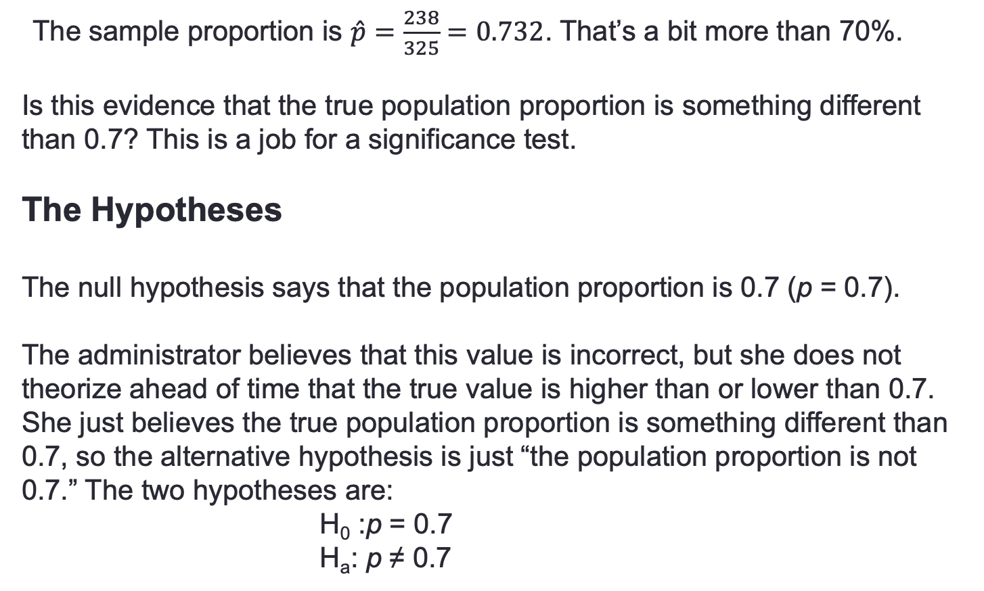
Example Working through College: Testing
The sample proportion is $\hat{p}=\frac{238}{325}=0.732$. That’s a bit more than 70%.
Is this evidence that the true population proportion is something different than 0.7? This is a job for a significance test.
The Hypotheses
The null hypothesis says that the population proportion is 0.7 (p = 0.7).
The administrator believes that this value is incorrect, but she does not theorize ahead of time that the true value is higher than or lower than 0.7. She just believes the true population proportion is something different than 0.7, so the alternative hypothesis is just “the population proportion is not 0.7.” The two hypotheses are:
H₀ :p = 0.7
H_{a}: p ≠ 0.7

Slide 44
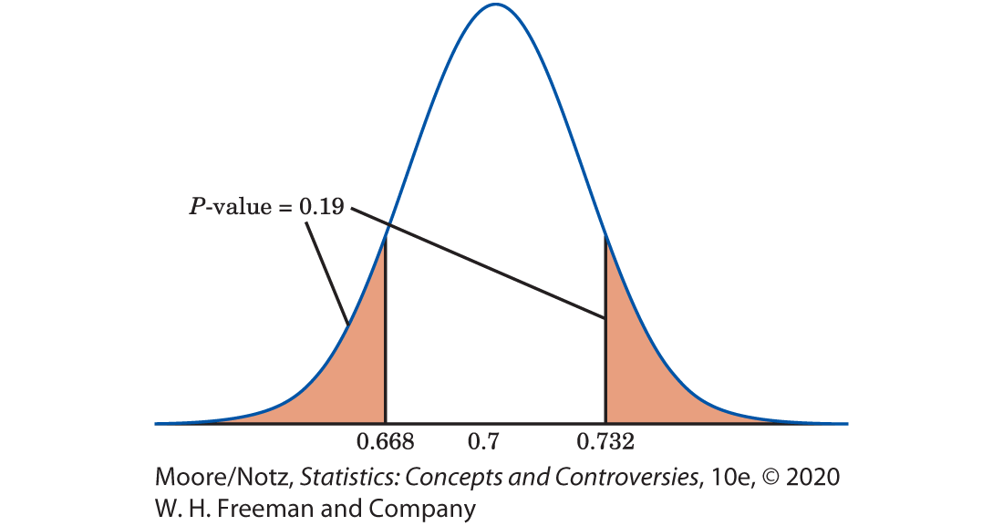
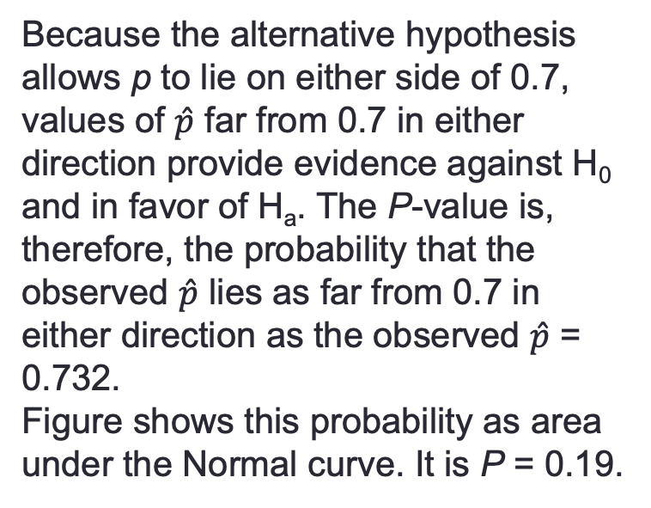
Example Working through College: P-value
Because the alternative hypothesis allows p to lie on either side of 0.7, values of $\hat{p}$ far from 0.7 in either direction provide evidence against H₀ and in favor of H_{a}. The P-value is, therefore, the probability that the observed $\hat{p}$ lies as far from 0.7 in either direction as the observed $\hat{p}$ = 0.732.
Figure shows this probability as area under the Normal curve. It is P = 0.19.
The P-value
The Conclusion
If the true population proportion is 0.7, the probability we would obtain a sample proportion this far or farther from 0.7 is 0.19.
We therefore cannot reject the claim that 70% of college students work full- or part-time while attending college.

Slide 45
One sided and Two sided Tests
The alternative H_{a}: p > 0.5 in the Coffee Example is a one-sided alternative because the effect we seek evidence for says that the population proportion is greater than one-half.
The alternative H_{a}: p ≠ 0.7 in the College Example is a two-sided alternative because we ask whether or not the proportion differs from 0.7. Whether the alternative is one-sided or two-sided determines whether sample results that are extreme in one direction or in both directions count as evidence against H₀ in favor of H_{a}.

Slide 46
Statistical Significance
We can decide in advance how much evidence against H₀ we will insist on.
The way to do this is to say, before any data are collected, how small a P-value we require.
The decisive value of P is called the significance level.
It is usual to write the significance level as α, the Greek letter alpha.
If we choose α = 0.05, we are requiring that the data give evidence against H₀ so strong that it would happen no more than 5% of the time (one time in 20) when H₀ is true.
If the P-value is as small or smaller than α, we say that the data are statistically significant at level α.

Slide 47
Statistical Significance or not likely to happen just by chance
Significant in the statistical sense does not mean “important.’’ It means simply “not likely to happen just by chance.’’
You will often see significance at level 0.01 expressed by the statement, “The results were significant (P < 0.01).’’ Here, P stands for the P-value.
One traditional level of significance to use is 0.05. The origins of this appear to trace back to the British statistician and geneticist Sir Ronald A. Fisher.
Fisher once wrote that it was convenient to consider sample statistics that are two or more standard deviations away from the mean as being significant.
Of course, we don’t have to make use of traditional levels of significance such as 5% and 1%.

Slide 48
Evidence against the null Hypothesis
The P-value is more informative because it allows us to assess significance at any level we choose.
A result with P = 0.03 is significant at the α = 0.05 level but not significant at the α = 0.01 level.
Nonetheless, the traditional significance levels are widely accepted guidelines for “how much evidence is enough.’’ We might say that P < 0.10 indicates “some evidence’’ against the null hypothesis, P < 0.05 is “moderate evidence,’’ and P < 0.01 is “strong evidence.’’

Slide 49
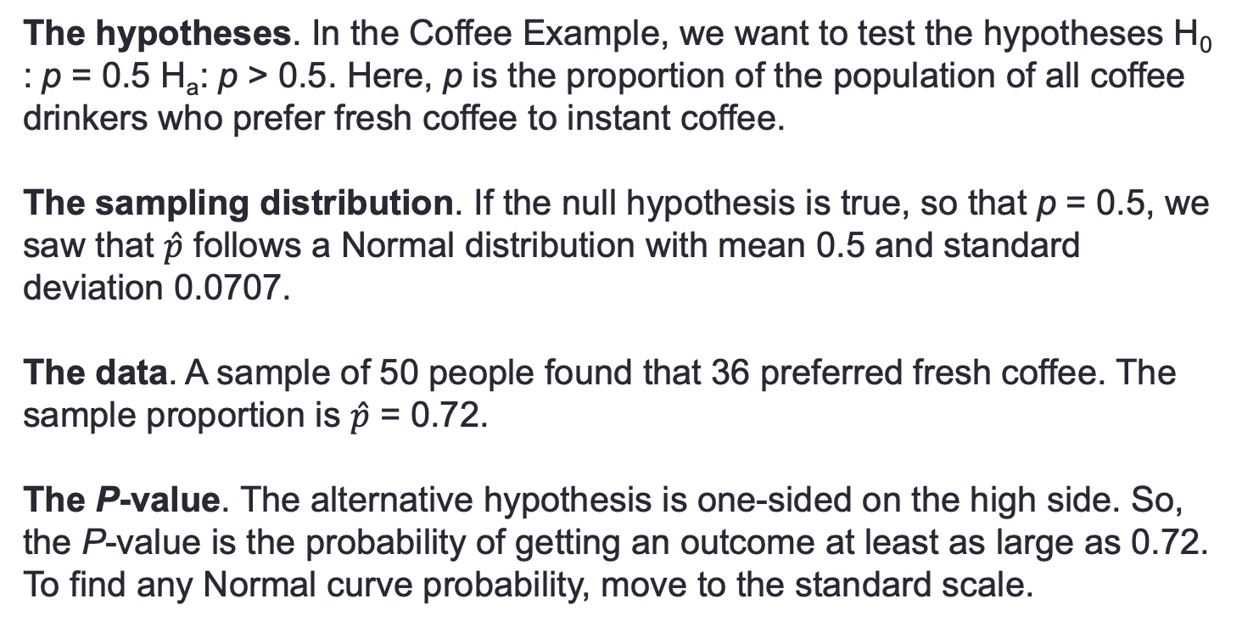
Example Tasting Coffee: Testing
The hypotheses. In the Coffee Example, we want to test the hypotheses H₀ : p = 0.5 H_{a}: p > 0.5. Here, p is the proportion of the population of all coffee drinkers who prefer fresh coffee to instant coffee.
The sampling distribution. If the null hypothesis is true, so that p = 0.5, we saw that $\hat{p}$ follows a Normal distribution with mean 0.5 and standard deviation 0.0707.
The data. A sample of 50 people found that 36 preferred fresh coffee. The sample proportion is $\hat{p}$ = 0.72.
The P-value. The alternative hypothesis is one-sided on the high side. So, the P-value is the probability of getting an outcome at least as large as 0.72. To find any Normal curve probability, move to the standard scale.

Slide 50
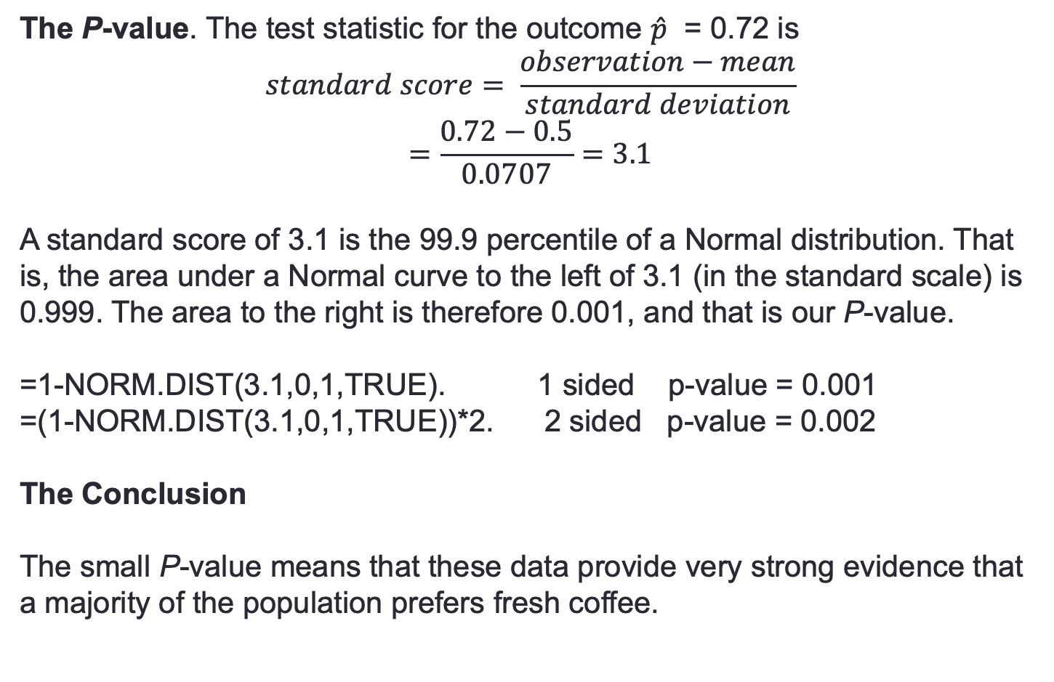
Example Tasting Coffee: P-Value
The P-value. The test statistic for the outcome $\hat{p}$ = 0.72 is
$$standard score= \frac{observation−mean}{standard deviation}$$
$$=\frac{0.72−0.5}{0.0707}=3.1$$
A standard score of 3.1 is the 99.9 percentile of a Normal distribution. That is, the area under a Normal curve to the left of 3.1 (in the standard scale) is 0.999. The area to the right is therefore 0.001, and that is our P-value.
=1-NORM.DIST(3.1,0,1,TRUE). 1 sided p-value = 0.001
=(1-NORM.DIST(3.1,0,1,TRUE))*2. 2 sided p-value = 0.002
The Conclusion
The small P-value means that these data provide very strong evidence that a majority of the population prefers fresh coffee.

Slide 51
Tests for a Population Mean
The reasoning that leads to significance tests for hypotheses about a population mean µ follows the reasoning that leads to tests about a population proportion p.
The big idea is to use the sampling distribution that the sample mean $\overline{x}$ would have if the null hypothesis were true.
Locate the value of $\overline{x}$ from your data on this distribution, and see if it is unlikely. A value of $\overline{x}$ that would rarely appear if H₀ were true is evidence that H₀ is not true.

Slide 52
Example Length of Human Pregnancies
Although women are typically given a delivery date that is calculated as 280 days after the onset of their last menstrual period, only 4% of women deliver babies at 280 days.
A more likely average time from ovulation to birth may be much less than 280 days.
To test this theory, a random sample of 95 women with healthy pregnancies is monitored from ovulation to birth.

Slide 53
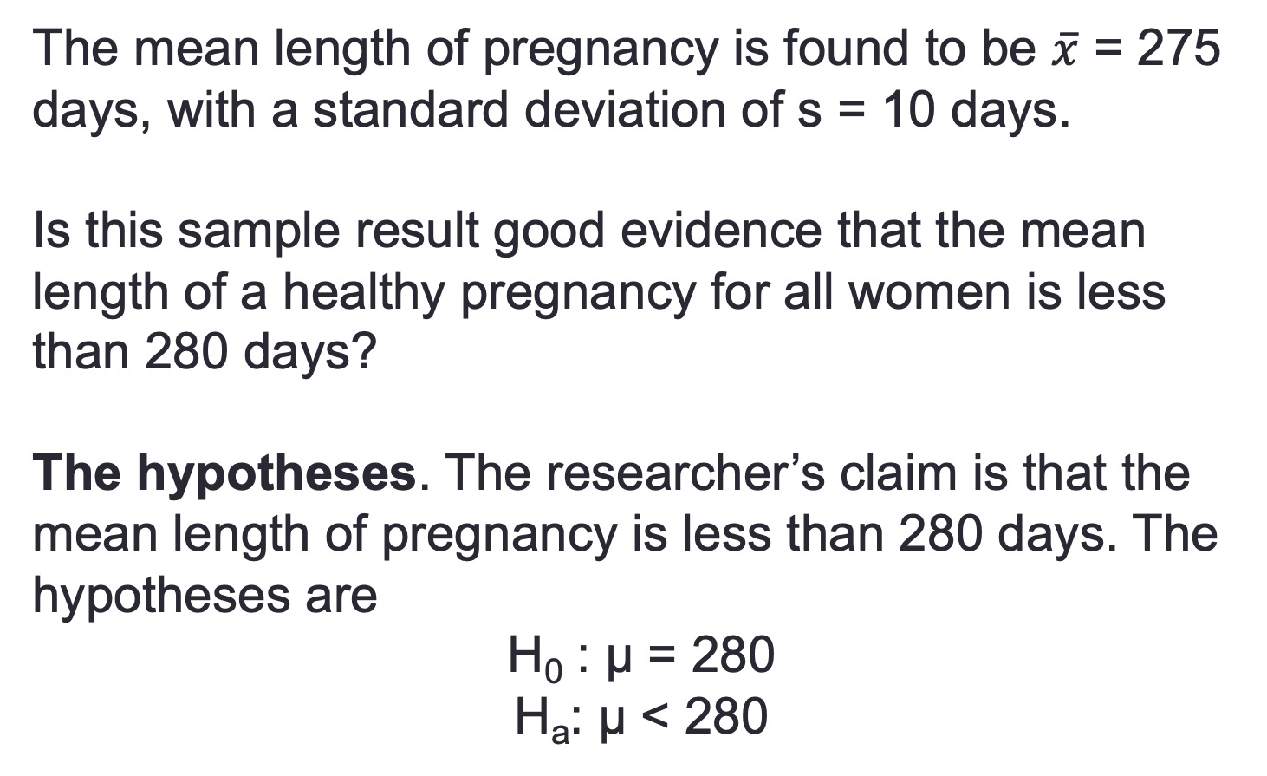
Example Length of Human Pregnancies
The mean length of pregnancy is found to be $\overline{x}$ = 275 days, with a standard deviation of s = 10 days.
Is this sample result good evidence that the mean length of a healthy pregnancy for all women is less than 280 days?
The hypotheses. The researcher’s claim is that the mean length of pregnancy is less than 280 days. The hypotheses are
H₀ : µ = 280
H_{a}: µ < 280

Slide 54
Example: Length of Human Pregnancies
The sampling distribution. If the null hypothesis is true, the sample mean $\overline{x}$ has approximately the Normal distribution with mean µ = 280 and standard error $\frac{s}{\sqrt{n}}=\frac{10}{\sqrt{95}}=1.03$
We once again use the sample standard deviation s in place of the unknown population standard deviation σ.

Slide 55
Example: Length of Human Pregnancies 4
The data. The researcher’s sample gave $\overline{x}$ = 275. The standard score, or test statistic, for this outcome is
$$standard score=\frac{observation−mean}{standard error}$$
$$=\frac{275−280}{1.03}=−4.85$$
That is, the sample result is about 4.85 standard errors below the mean we would expect if, on the average, healthy pregnancies lasted for 280 days.

Slide 56
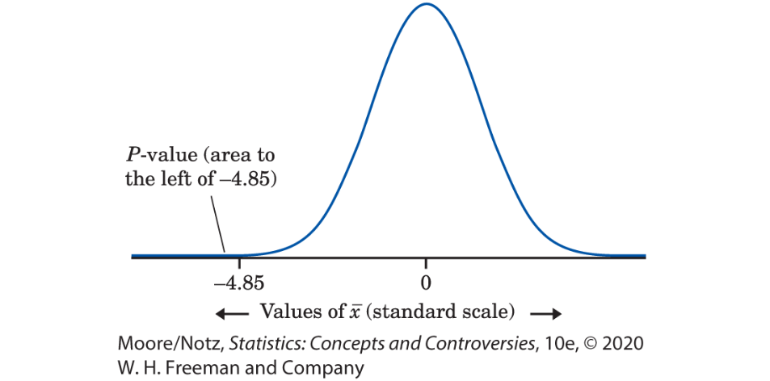
Example: Length of Human Pregnancies 5
The P-value
The P-value for our one-sided test is the area to the left of -4.85 under the Normal curve. =NORM.DIST(-4.85,0,1,TRUE)
1 sided test with
p-value = 0.000001
The Conclusion
A P-value of 0.000001 is strong evidence that the mean length of a healthy human pregnancy is below the commonly reported length of 280 days.

Slide 57
Statistics in Summary
• A test of significance assesses the evidence for some claim about the value of an unknown parameter.
• In practice, the purpose of a statistical test is to answer the question, “Could the effect we see in the sample just be an accident due to chance, or is it good evidence that the effect is really there in the population?’’
Significance tests answer this question by giving the probability that a sample effect as large as the one we see in this sample would arise just by chance. This probability is P-value. A small P-value says that our outcome is unlikely to happen just by chance.
• To set up a test, state a null hypothesis that says the effect you seek is not present in the population. The alternative hypothesis says that the effect is present.
The P-value is the probability, calculated taking the null hypothesis to be true, of an outcome as extreme in the direction specified by the alternative hypothesis as the actually observed outcome.
• A sample result is statistically significant at the 5% level if it would occur just by chance no more than 5% of the time in repeate samples.

Slide 58
To Review:
Inference
What is a confidence interval?
What is a test of significance?
Use and Abuse of Statistical Inference
Two-Way Tables and the Chi-Square test
Homework # 2 Review
Helper1
Helper 2
Helper 3
Linear Regression Summary
Helper 4

Slide 59

Case Study Mutual Funds: Highest Returns
Suppose we take a look at the more than 10,000 mutual funds on sale to the investing public.
Any Internet investment site worth clicking on will tell you which funds produced the highest returns over the past (say) 3 years.

Slide 60
Case Study Mutual Funds: Statistical Significance
In 2011, one site claimed that the ProFunds Internet Inv. Fund was among the top 1% over the 3 preceding years.
If we had bought this fund in 2008, we would have gained 50.2% per year.
Comparing this return with the average over this period for all funds, we find that ProFunds Internet Inv. Fund return is significantly higher.
Doesn’t statistical significance suggest that the ProFunds Internet Inv. Fund is a good investment?

Slide 61
Using Inference Wisely
We have met the two major types of statistical inference: confidence intervals and significance tests.
We have, however, seen only two inference methods of each type, one designed for inference about a population proportion p and the other designed for inference about a population mean µ.
There are many methods for inference about various parameters in various settings. The reasoning of confidence intervals and significance tests remains the same, regardless of the method.

Slide 62
Using Inference Wisely
The first step in using inference wisely is to understand your data and the questions you want to answer and fit the method to its setting.
The design of the data production matters. “Where do the data come from?” remains the first question to ask in any statistical study.

Slide 63
Using Inference Wisely
For our confidence interval and test for a proportion p:
• The data must be a simple random sample (SRS) from the population of interest. When you use these methods, you are acting as if the data are an SRS. In practice, it is often not possible to actually choose an SRS from the population. Your conclusions may then be open to challenge.
• These methods are not correct for sample designs more complex than an SRS, such as stratified samples. There are other methods that fit these settings.

Slide 64
Using Inference Wisely
For our confidence interval and test for a proportion p:
• There is no correct method for inference from data haphazardly collected with bias of unknown size. Fancy formulas cannot rescue badly produced data.
• Other sources of error, such as dropouts and nonresponse, are important. Remember that confidence intervals and tests use the data you collect and ignore these errors.

Slide 65
Using Inference Wisely
Know how confidence intervals behave. All confidence intervals share these behaviors:
• The confidence level says how often the method catches the true parameter when sampling many times. We never know whether this specific data set gives us an interval that contains the true value of the parameter. All we can say is that “we got this result from a method that works 95% of the time.” This data set might be one of the 5% that produce an interval that misses the true value of the parameter. If that risk is too high for you, use a 99% confidence interval.

Slide 66
Using Inference Wisely
Know how confidence intervals behave. All confidence intervals share these behaviors:
• High confidence is not free. A 99% confidence interval will be wider than a 95% confidence interval based on the same data. To be more confident, we must have more values to be confident about. There is a trade-off between how closely we can pin down the true value of the parameter (the precision of the confidence interval) and how confident we are that we have captured its true value.

Slide 67
Using Inference Wisely
Know how confidence intervals behave. All confidence intervals share these behaviors:
• Larger samples give narrower intervals. If we want high confidence and a narrow interval, we must take a larger sample. The width of our confidence interval for p goes down by a factor of the square root of the sample size. To cut the interval in half, we must take four times as many observations. This is typical of many types of confidence intervals.

Slide 68
Using Inference Wisely
Know what statistical significance says.
Many statistical studies hope to show that some claim is true.
The purpose of significance tests is to weigh the evidence that the data give in favor of such claims.
That is, a test helps us know if we found what we were looking for.

Slide 69
Using Inference Wisely
Know what statistical significance says.
To do this, we ask what would happen if the claim were not true.
That’s the null hypothesis—no difference between the two drugs, no difference between women and men.
A significance test answers only one question: “How strong is the evidence that the null hypothesis is not true?”
A test answers this question by giving a P-value.

Slide 70
Using Inference Wisely
Know what statistical significance says.
The P-value tells us how likely data as or more extreme than ours would be if the null hypothesis were true.
Data that are very unlikely and have a small P-value are good evidence that the null hypothesis is not true.
This kind of indirect evidence against the null hypothesis (and for the effect we hope to find) is less straightforward than a confidence interval.

Slide 71
Using Inference Wisely
Know what your methods require.
Our significance test and confidence interval for a population proportion p require that the population size be much larger than the sample size.
They also require that the sample size itself be reasonably large so that the sampling distribution of the sample proportion $\hat{p}$ is close to Normal.

Slide 72
Using Inference Wisely
Know what your methods require.
Does the study ask the right questions?
Where did the data come from?
Do the results make sense?
Does the study report confidence intervals so you can see both the estimated values of important parameters and how uncertain the estimates are?
Does it report P-values to help convince you that findings are not just good luck?

Slide 73
The Woes of Significance Tests
The purpose of a significance test is usually to give evidence for the presence of some effect in the population.
The effect might be a probability of heads different from one-half for a coin or a longer mean survival time for patients given a new cancer treatment.
If the effect is large, it will show up in most samples: the proportion of heads among our tosses will be far from one-half, or the patients who get the new treatment will live much longer than those in the control group.

Slide 74
The Woes of Significance Tests
Small effects, such as a probability of heads only slightly different from one-half, will often be hidden behind the chance variation in a sample.
This is as it should be: big effects are easier to detect.
That is, the P-value will usually be small when the population truth is far from the null hypothesis.
A test measures only the strength of evidence against the null hypothesis. It says nothing about how big or how important the effect we seek in the population really is.

Slide 75
The Woes of Significance Tests
Pay particular attention to the size of the sample when you read the result of a significance test. Here’s why:
• Larger samples make tests of significance more sensitive. If we toss a coin hundreds of thousands of times, a test of H₀: p = 0.5 will often give a very low P-value when the truth for this coin is p = 0.502. The test is right—it found good evidence that p really is not exactly equal to 0.5—but it has picked up a difference so small that it is of no practical interest. A finding can be statistically significant without being practically important.

Slide 76
The Woes of Significance Tests
• On the other hand, tests of significance based on small samples are often not sensitive. If you toss a coin only 10 times, a test of H₀: p = 0.5 will often give a large P-value even if the truth for this coin is p = 0.7. Again, the test is right—10 tosses are not enough to give good evidence against the null hypothesis. Lack of significance does not mean that there is no effect, only that we do not have good evidence for an effect. Small samples often miss important effects that are really present in the population. As the cosmologist Martin Rees said, “Absence of evidence is not evidence of absence.”

Slide 77
Example: Antidepressants versus a Placebo
Through a Freedom of Information Act request, two psychologists obtained 47 studies used by the Food and Drug Administration for approval of the six antidepressants prescribed most widely between 1987 and 1999. Overall, the psychologists found that there was a statistically significant difference in the effects of antidepressants compared with a placebo, with antidepressants being more effective. However, the psychologists went on to report that antidepressant pills worked 18% better than placebos, a statistically significant difference, “but not meaningful for people in clinical settings.’’

Slide 78
The Woes of Significance Tests
Whatever the truth about the population, whether p = 0.7 or p = 0.502, more observations allow us to estimate p more closely.
If p is not 0.5, more observations will give more evidence of this, that is, a smaller P-value.
Because statistical significance depends strongly on the sample size as well as on the truth about the population, statistical significance tells us nothing about how large or how practically important an effect is.

Slide 79
The Woes of Significance Tests
Large effects (such as p = 0.7 when the null hypothesis is p = 0.5) often give data that are insignificant if we take only a small sample.
Small effects (such as p = 0.502) often give data that are highly significant if we take a large enough sample.

Slide 80
The Woes of Significance Tests
Beware the naked P-value
The P-value of a significance test depends strongly on the size of the sample, as well as on the truth about the population.
It is bad practice to report a naked P-value (a P-value by itself) without also giving the sample size and a statistic or statistics that describe the sample outcome.

Slide 81
The Advantages of Confidence Intervals
Give a confidence interval
Confidence intervals are more informative than significance tests because they actually estimate a population parameter.
They are also easier to interpret.
It is good practice to give confidence intervals whenever possible.

Slide 82
Significance at the 5% Level Isn’t Magical
The P-value of a test of significance describes the degree of evidence provided by the sample against the null hypothesis.
How small a P-value is convincing evidence against the null hypothesis?

Slide 83
Significance at the 5% Level Isn’t Magical
This depends mainly on two circumstances:
• How plausible is H₀? If H₀ represents an assumption that the people you must convince have believed for years, strong evidence (small P) will be needed to persuade them.
• What are the consequences of rejecting H₀? If rejecting H₀ in favor of H_{a} means making an expensive changeover from one type of product packaging to another, you need strong evidence that the new packaging will boost sales.

Slide 84
Significance at the 5% Level Isn’t Magical
Different people will often insist on different levels of significance.
Giving the P-value allows each of us to decide individually if the evidence is sufficiently strong.
But the level of significance that will satisfy us should be decided before calculating the P-value.
Computing the P-value and then deciding that we are satisfied with a level of significance that is just slightly larger than this P-value is an abuse of significance testing.

Slide 85
Significance at the 5% Level Isn’t Magical
Users of statistics have often emphasized standard levels of significance such as 10%, 5%, and 1%.
Courts have tended to accept 5% as a standard in discrimination cases.
This emphasis reflects the time when tables of critical values rather than computer software dominated statistical practice.

Slide 86
Significance at the 5% Level Isn’t Magical
The 5% level (α = 0.05) is particularly common.
There is no sharp border between “significant” and “insignificant,” only increasingly strong evidence as the P-value decreases.
There is no practical distinction between the P-values 0.049 and 0.051. It makes no sense to treat P ≤ 0.05 as a universal rule for what is significant.

Slide 87
Beware of Searching for Significance
Statistical significance ought to mean that you have found an effect that you were looking for.
The reasoning behind statistical significance works well if you decide what effect you are seeking, design a study to search for it, and use a test of significance to weigh the evidence you get.
In other settings, significance may have little meaning. In an exploratory data analysis, you may find patterns with significant P-values.

Slide 88
Beware of Searching for Significance
Searching data for suggestive patterns is certainly legitimate.
Exploratory data analysis is an important part of statistics. But the reasoning of formal inference does not apply when your search for a striking effect in the data is successful.
The remedy is clear. Once you have a hypothesis, design a study to search specifically for the effect you now think is there. If the result of this study is statistically significant, you have real evidence.

Slide 89
Inference as Decision
Tests of significance were presented as methods for assessing the strength of evidence against the null hypothesis.
The assessment is made by the P-value, which is the probability computed under the assumption that the null hypothesis is true.
The alternative hypothesis (the statement we seek evidence for) enters the test only to help us see what outcomes count against the null hypothesis.

Slide 90
Inference as Decision
A level of significance chosen in advance points to the outcome of the test as a decision.
If the P-value is less than ≤ α, we reject H₀ in favor of H_{a.} Otherwise, we fail to reject H₀.
It can be argued (and is argued by followers of Fisher) that making decisions is too grand a goal, especially in scientific inference.
A decision is reached only after the evidence of many experiments is weighed, and, indeed, the goal of research is not “decision” but a gradually evolving understanding.
It is rare (outside textbooks) to set up a level α in advance as a rule for decision making in a scientific problem.

Slide 91
Inference as Decision
More commonly, users think of significance at level 0.05 as a description of good evidence.
This is made clearer by talking about P-values, and this newer language is spreading.

Slide 92
Inference as Decision
Yet there are circumstances in which a decision or action is called for as the end result of inference.
Acceptance sampling is one such circumstance.
The supplier of a product (for example, potatoes to be used to make potato chips) and the consumer of the product agree that each truckload of the product shall meet certain quality standards.
When a truckload arrives, the consumer chooses a sample of the product to be inspected.
On the basis of the sample outcome, the consumer will either accept or reject the truckload.

Slide 93
Inference as Decision
Tests of significance fasten attention on H₀, the null hypothesis. If a decision is called for, however, there is no reason to single out H₀.
There are simply two alternatives, and we must accept one and reject the other.
It is convenient to call the two alternatives H₀ and H_{a}, but H₀.

Slide 94
Inference as Decision
In the acceptance sampling problem, we must decide between
H₀: the truckload of product meets standards
H_{a}: the truckload does not meet standards
on the basis of a sample of the product. There is no reason to put the burden of proof on the consumer by accepting H₀ unless we have strong evidence against it.

Slide 95
Inference as Decision
It is equally sensible to put the burden of proof on the producer by accepting H_{a} unless we have strong evidence that the truckload meets standards.
Producer and consumer must agree on where to place the burden of proof, but neither H₀ nor H_{a} has any special status.

Slide 96
Inference as Decision
In a decision problem, we must give a decision rule: a recipe based on the sample that tells us what decision to make.
Decision rules are expressed in terms of sample statistics, usually the same statistics we would use in a test of significance.
In fact, we have already seen that a test of significance becomes a decision rule if we reject H₀ (accept H_{a}) when the sample statistics is statistically significant at level α and otherwise accept H₀ (reject H_{a}).

Slide 97
Inference as Decision
Suppose, then, that we use statistical significance at level α as our criterion for decision. And suppose that the null hypothesis H₀ is really true.
Then, sample outcomes significant at level α will occur with probability α.
But now we make a wrong decision in all such outcomes by rejecting H₀ when it is really true.
That is, significance level α now can be understood as the probability of a certain type of wrong decision.

Slide 98
Inference as Decision
Now H_{a} requires equal attention.
Just as rejecting H₀ (accepting H_{a}) when H₀ is really true is an error, so is accepting H₀ (rejecting H_{a}) when H_{a} is really true.
We can make two kinds of errors.
If we reject H₀ (accept H_{a}) when in fact H₀ is true, this is a Type I error.
If we accept H₀ (reject H_{a}) when in fact H_{a} is true, this is a Type II error.

Slide 99
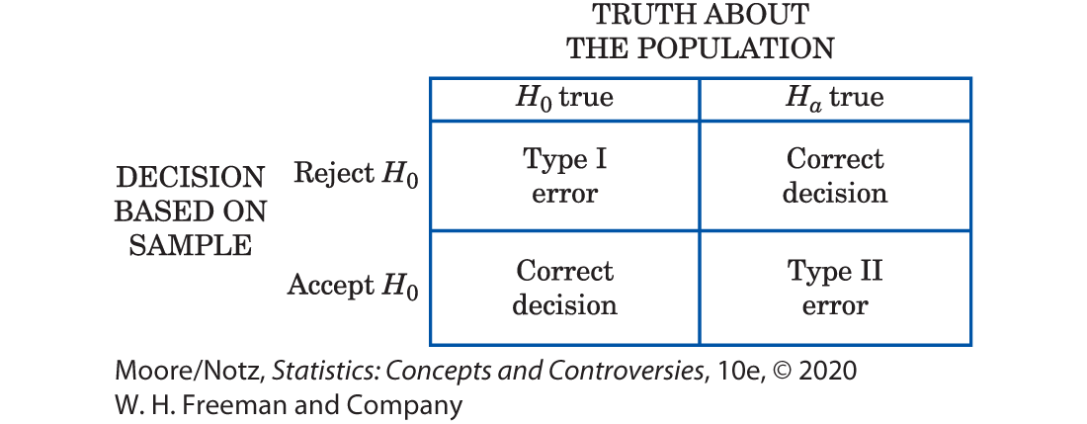
Inference as Decision

Slide 100
Inference as Decision
So the significance level α is the probability of a Type I error.
In acceptance sampling, this is the probability that a good truckload will be rejected.
The probability of a Type II error is the probability that a bad truckload will be accepted.

Slide 101
Inference as Decision
Any decision rule is assessed in terms of the probabilities of the two types of error.
This is in keeping with the idea that statistical inference is based on probability.
We cannot (short of inspecting the whole truckload) guarantee that good lots will never be rejected and bad lots never accepted.

Slide 102
Inference as Decision
But by random sampling and the laws of probability, we can say what are the probabilities of both kinds of errors.
Because we can find out the monetary cost of accepting bad truckloads and rejecting good ones, we can determine how much loss the producer and consumer each will suffer in the long run from wrong decisions.

Slide 103
Inference as Decision
Advocates of decision theory argue that the kind of “economic” thinking natural in acceptance sampling applies to all inference problems.
Even a scientific researcher decides whether to announce results, or to do another experiment, or to give up research as unproductive.
Wrong decisions carry costs, though these costs are not always measured in dollars.
A scientist suffers by announcing a false effect, and also by failing to detect a true effect.

Slide 104
Inference as Decision
Decision theorists maintain that the scientist should try to give numerical weights (called utilities) to the consequences of the two types of wrong decision.
Then, the scientist can choose a decision rule with the error probabilities that reflect how serious the two kinds of error are.
This argument has won favor where utilities are easily expressed in money.

Slide 105
Inference as Decision
Decision theory is widely used by business in making capital investment decisions, for example.
But scientific researchers have been reluctant to take this approach to statistical inference.

Slide 106
Inference as Decision
In summary, in a test of significance, we focus on a single hypothesis (H₀) and single probability (the P-value).
The goal is to measure the strength of the sample evidence against H₀.
If the same inference problem is thought of as a decision problem, we focus on two hypotheses and give a rule for deciding between them based on sample evidence. Therefore, we must focus on two probabilities: the probabilities of the two types of error.

Slide 107
Inference as Decision
Such a clear distinction between the two types of thinking is helpful for understanding.
In practice, the two approaches often merge, to the dismay of partisans of one or the other.
We continued to call one of the hypotheses in a decision problem H₀.
In the common practice of testing hypotheses, we mix significance tests and decision rules as follows.

Slide 108
Inference as Decision
• Choose H₀ as in a test of significance.
• Think of the problem as a decision problem, so the probabilities of Type I and Type II errors are relevant.
• Type I errors are usually more serious. So choose an α (significance level), and consider only tests with probability of Type I error no greater than α.
• Among these tests, select one that makes the probability of a Type II error as small as possible. If this probability is too large, you will have to take a larger sample to reduce the chance of an error.

Slide 109
Inference as Decision
Testing hypotheses may seen to be a hybrid approach.
It was, historically, the effective beginning of decision-oriented ideas in statistics.
Hypothesis testing was developed by Jerzey Neyman and Egon S. Pearson in the years 1928–1938.
The decision theory approach came later (1940s) and grew out of the Neyman-Pearson ideas.

Slide 110
Inference as Decision
Because decision theory in its pure form leaves you with two error probabilities and no simple rule on how to balance them, it has been used less often than tests of significance.
Decision theory ideas have been applied in testing problems mainly by way of the Neyman-Pearson theory.
Fisher, who was exceedingly argumentative, violently attacked the Neyman-Pearson decision-oriented ideas, and the argument still continues.

Slide 111
Inference as Decision
The reasoning of statistical inference is subtle, and the principles at issue are complex.
If you feel that you do not fully grasp all of the ideas, you are in excellent company.
Nonetheless, any user of statistics should make a serious effort to grasp the conflicting views on the nature of statistical inference.

Slide 112
Statistics in Summary
• Statistical inference is less widely applicable than exploratory analysis of data. Any inference method requires the right setting—in particular, the right design for a random sample or randomized experiment.
• Understanding the meaning of confidence levels and statistical significance helps prevent improper conclusions.
• Increasing the number of observations has a straightforward effect on confidence intervals: the interval gets shorter for the same level of confidence.

Slide 113
Statistics in Summary
• Taking more observations usually decreases the P-value of a test when the truth about the population stays the same, making significance tests harder to interpret than confidence intervals.
• A finding with a small P-value may not be practically interesting if the sample is large, and an important truth about the population may fail to be significant if the sample is small.

Slide 114
Statistics in Summary
• If a test of significance is thought of as a decision problem, we focus on two hypotheses, H₀ and H_{a}, and give a decision rule for deciding between them based on sample evidence. We can make two types of errors. If we reject H₀ (accept H_{a}) when, in fact, H₀ is true, this is a Type I error. If we accept H₀ (reject H_{a}) when, in fact, H_{a} is true, this is a Type II error.

Slide 115
To Review:
Inference
What is a confidence interval?
What is a test of significance?
Use and Abuse of Statistical Inference
Two-Way Tables and the Chi-Square test
Homework # 2 Review
Helper1
Helper 2
Helper 3
Linear Regression Summary
Helper 4

Slide 116

Case Study: Two-Way Tables and the Chi-Square Test* 1
Purdue is a Big Ten university that emphasizes engineering, scientific, and technical fields.
In the 2013–2014 academic year, Purdue had 1670 professors of all ranks (assistant, associate, and full), of whom 483 were women. That’s just under 29%, or slightly less than 3 out of every 10 professors.

Slide 117
Case Study: Two-Way Tables and the Chi-Square Test* 2
These numbers don’t tell us much about the fields of expertise of women on the faculty.
We need to look at relationships among several variables, not just at sex alone.
Female faculty members are more common in the humanities than in engineering.
We can also look at the relationship between sex and a variable particularly important to faculty members, academic rank.

Slide 118
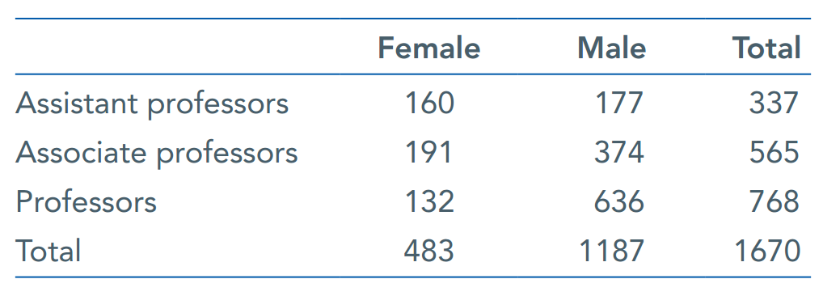
Case Study: Two-Way Tables and the Chi-Square Test* 3
Universities tend to be run by full professors.
Here is a two-way table that categorizes Purdue’s 1670 faculty members by both sex and academic rank (professors typically start at the rank of assistant, then associate, then full professor):

Slide 119
Case Study: Two-Way Tables and the Chi-Square Test* 4
What does this table tell us about the rank of women on the faculty?
In this chapter, we will learn how to interpret such tables. By the end of the chapter, you will be able to interpret this table.

Slide 120
Two-Way Tables 1
One measurement of student success is the percent completing a bachelor’s degree within 6 years.
The following two-way table is representative of the percents of students completing a bachelor’s degree within 6 years by race/ethnicity:
Race/ ethnicity | White | Black | Hispanic | Asian | American Indian/ Alaska Native | Two or more races | Total
Graduated | 6963 | 1063 | 1388 | 792 | 69 | 175 | 10,450
Did not graduate | 3933 | 1614 | 1163 | 295 | 110 | 119 | 7234
Total | 10,896 | 2667 | 2551 | 1087 | 179 | 294 | 17,684

Slide 121
Two-Way Tables 2
Graduation status (completing a bachelor’s degree within 6 years or not) and race of students are both categorical variables.
Use a two-way table to display the relationship between two categorical variables.
Race/ ethnicity | White | Black | Hispanic | Asian | American Indian/ Alaska Native | Two or more races | Total
Graduated | 6963 | 1063 | 1388 | 792 | 69 | 175 | 10,450
Did not graduate | 3933 | 1614 | 1163 | 295 | 110 | 119 | 7234
Total | 10,896 | 2667 | 2551 | 1087 | 179 | 294 | 17,684

Slide 122
Two-Way Tables 3
Graduation status is the row variable because each row in the table describes one of the possible admission decisions for a student.
Race is the column variable because each column describes one of the racial/ethnic groups.
Race/ ethnicity | White | Black | Hispanic | Asian | American Indian/ Alaska Native | Two or more races | Total
Graduated | 6963 | 1063 | 1388 | 792 | 69 | 175 | 10,450
Did not graduate | 3933 | 1614 | 1163 | 295 | 110 | 119 | 7234
Total | 10,896 | 2667 | 2551 | 1087 | 179 | 294 | 17,684

Slide 123
Two-Way Tables 4
Race/ ethnicity | White | Black | Hispanic | Asian | American Indian/ Alaska Native | Two or more races | Total
Graduated | 6963 | 1063 | 1388 | 792 | 69 | 175 | 10,450
Did not graduate | 3933 | 1614 | 1163 | 295 | 110 | 119 | 7234
Total | 10,896 | 2667 | 2551 | 1087 | 179 | 294 | 17,684
The “Total” column at the right of the table contains the totals for graduation status for all students (for all racial/ethnic groups combined).
The “Total” row at the bottom of the table gives the distribution of race for students (with both categories of graduation status combined).

Slide 124
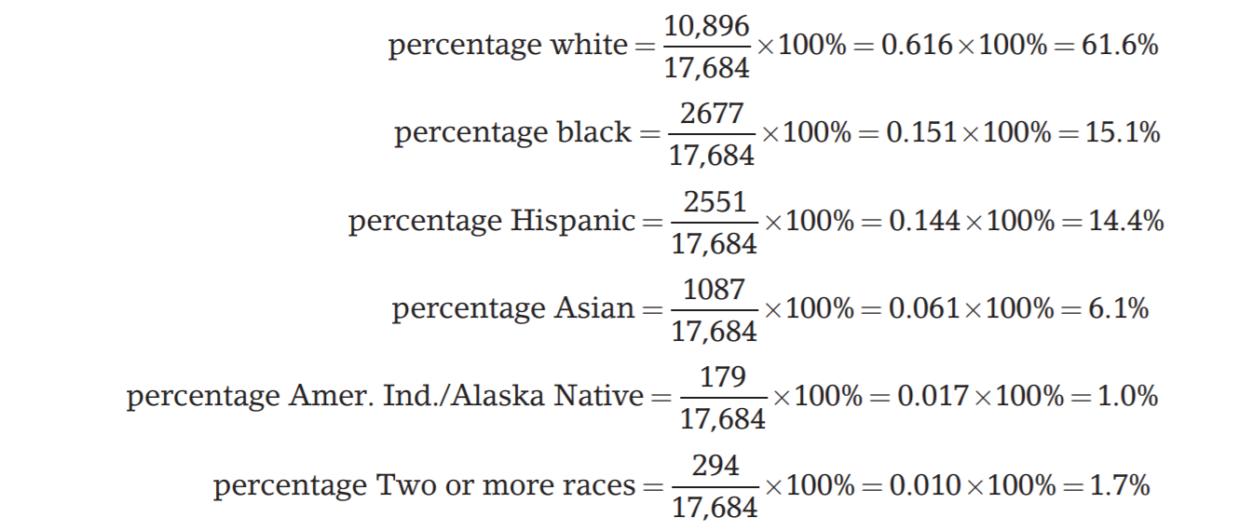
Two-Way Tables 5
It is often clearer to present these distributions
using percentages. We might report the distribution
of race as:

Slide 125
Two-Way Tables 6
The nature of the relationship between graduation status and race cannot be deduced from the separate distributions but requires the full table.
To describe relationships among categorical variables, calculate appropriate percents from the counts given.

Slide 126
Two-Way Tables 7
Race/ ethnicity | White | Black | Hispanic | Asian | American Indian/ Alaska Native | Two or more races | Total
Graduated | 6963 | 1063 | 1388 | 792 | 69 | 175 | 10,450
Did not graduate | 3933 | 1614 | 1163 | 295 | 110 | 119 | 7234
Total | 10,896 | 2667 | 2551 | 1087 | 179 | 294 | 17,684
Because there are only two categories of graduation status, we can see the relationship between race and graduation status by comparing the percents of those who completed a bachelor’s degree within 6 years for each race:

Slide 127
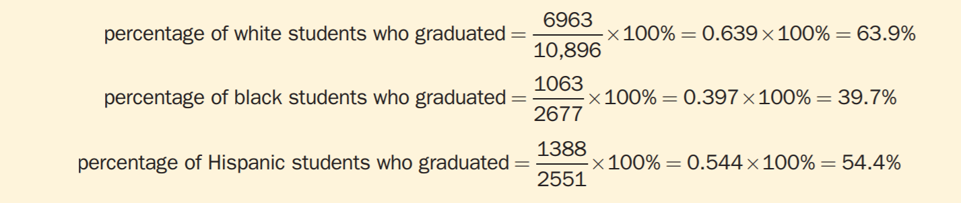
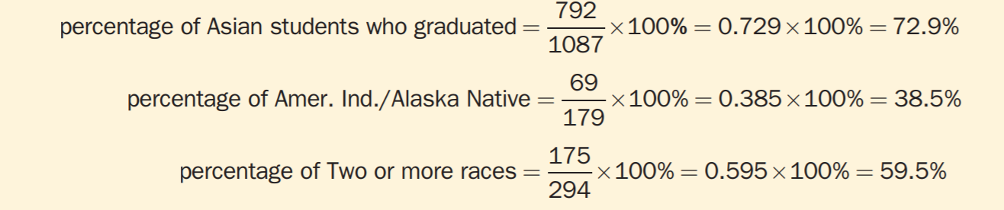
Two-Way Tables 8
Over 60% of the white students and more than 70% of the Asian students completed a bachelor’s degree within 6 years, but less than 40% of black students and American Indian/Alaska Native students completed a bachelor’s degree within 6 years.

Slide 128
Inference for a Two-Way Table 1
Imagine displaying data in a two-way table to see if two categorical variables are related to each other.
Look at sample data, turn them into percentages, and look for an association between the row and column variables.
Is the association in the sample evidence of an association between these variables in the entire population?
This is a question for a significance test.

Slide 129
Example: Treating Cocaine Addiction
Cocaine addicts need the drug to feel pleasure. Perhaps, giving them a medication that fights depression will help them resist cocaine.
A 3-year study compared an antidepressant called desipramine, lithium (a standard treatment for cocaine addiction), and a placebo.
The subjects were 72 chronic users of cocaine who wanted to break their drug habit. An equal number of the subjects were randomly assigned to each treatment.

Slide 130
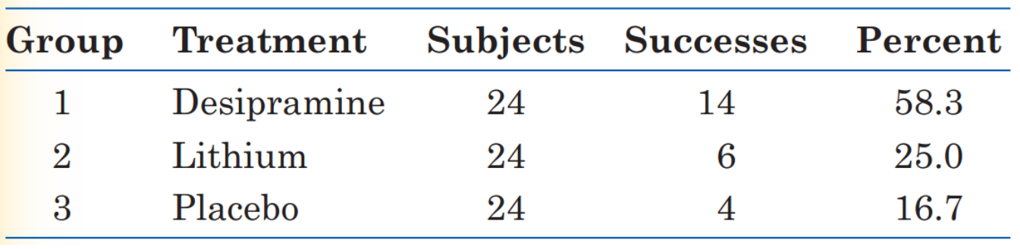
Example: Treating Cocaine Addiction (continued)
The sample proportions of subjects who did not use cocaine are quite different.
The percentage of subjects in the desipramine group who did not use cocaine was much higher than for the lithium or placebo group.

Slide 131
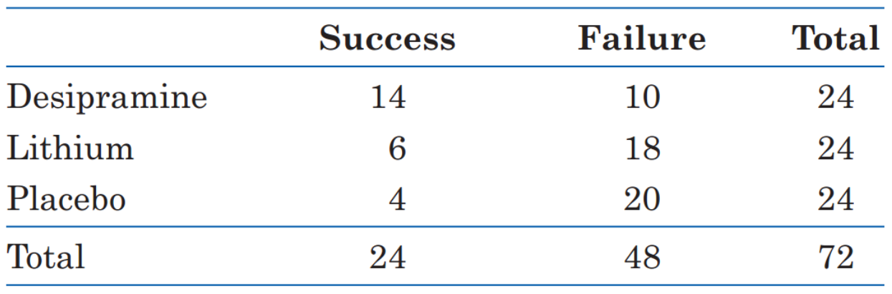
Inference for a Two-Way Table 2
The test that answers this question starts with a two-way table.
Here’s the table for the data:

Slide 132
Inference for a Two-Way Table 3
Our null hypothesis, as usual, says that the treatments have no effect.
That is, addicts do equally well on any of the three treatments. The differences in the sample are just the result of chance. Our null hypothesis is:
H₀: There is no association between the treatment an addict receives and whether or not there is success in not using cocaine in the population of all cocaine addicts.

Slide 133
Inference for a Two-Way Table 4
The alternative hypothesis says, “Yes, there is some association between the treatment an addict receives and whether or not he succeeds in staying off cocaine.”
H_{a}: There is an association between the treatment an addict receives and whether or not there is success in not using cocaine in the population of all cocaine addicts.

Slide 134
Inference for a Two-Way Table 5
To test H₀, we compare the observed counts in a two-way table with the expected counts.
The expected counts are what we would expect—except for random variation—if H₀ were true.
If the observed counts are far from the expected counts, that is evidence against H₀.

Slide 135
Inference for a Two-Way Table 6
In all, 24 of the 72 subjects succeeded, which is an overall success rate of one-third because ${24}/{72}$ is one-third.
If the null hypothesis is true, there is no difference among the treatments. So we expect one-third of the subjects in each group to succeed.
There were 24 subjects in each group, so we expect 8 successes and 16 failures in each group.
If the treatment groups differ in size, the expected counts will differ.

Slide 136
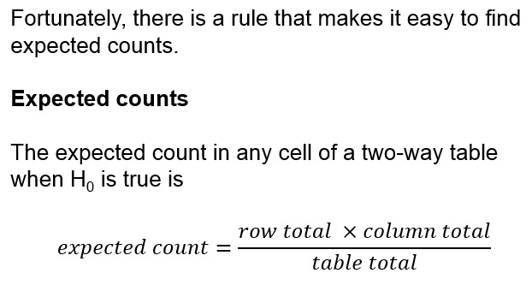
Inference for a Two-Way Table 7

Slide 137
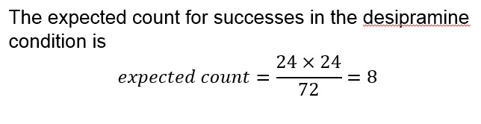
Inference for a Two-Way Table 8

Slide 138
The Chi-Square Test 1
To see if the data give evidence against the null hypothesis of “no relationship,’’ compare the counts in the two-way table with the counts we would expect if there really were no relationship.
If the observed counts are far from the expected counts, that’s the evidence we were seeking.
The significance test uses a statistic that measures how far apart the observed and expected counts are.

Slide 139
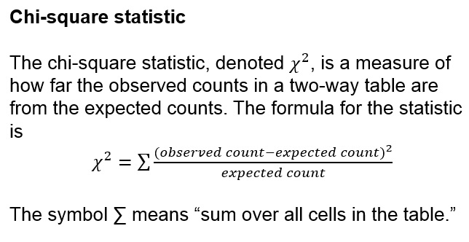
The Chi-Square Test 2

Slide 140
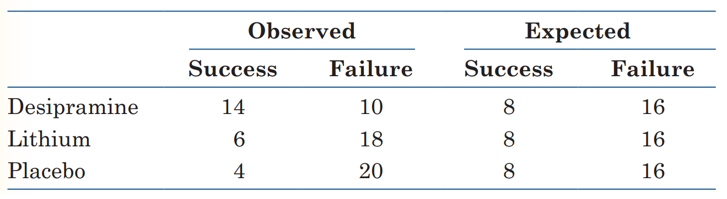
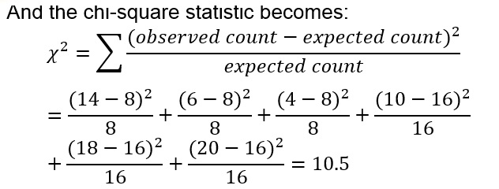
The Chi-Square Test 3

Slide 141
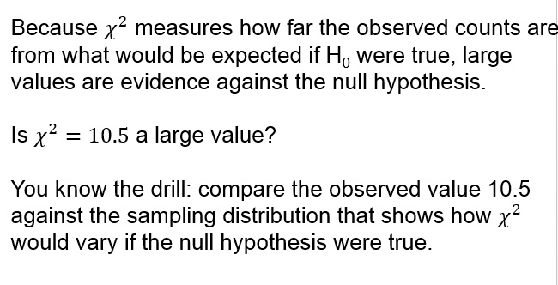
The Chi-Square Test 4

Slide 142
The Chi-Square Test 5
This is not a normal distribution.
It is a right-skewed distribution, whose values cannot be negative.
This sampling distribution is different for two-way
tables of different sizes.

Slide 143
The Chi-Square Test 6
The sampling distribution of the chi-square statistic$χ^{2}$ when the null hypothesis of no association is true is called a chi-square distribution.
The chi-square distributions are a family of distributions that take only non-negative values and are skewed to the right.
A specific chi-square distribution is specified by giving its degrees of freedom.
The chi-square test for a two-way table with r rows and c columns uses critical values from the chi-square distribution with (r −1)(c −1) degrees of freedom.

Slide 144
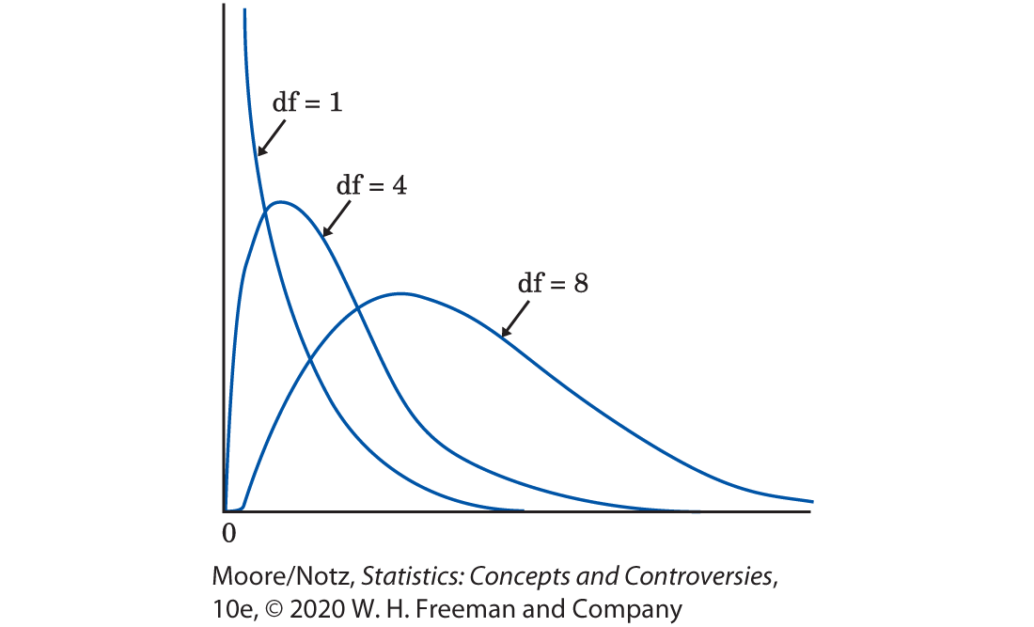
The Chi-Square Test 7

Slide 145
The Chi-Square Test 8
We let software get the areas under the chi-square curve to calculate P-values for us. Table 24.1 is a shortcut.
It shows how large the chi-square statistic must be in order to be significant at various levels. Each number of degrees of freedom has a separate row in the table. We see, for example, that a chi-square statistic with 3 degrees of freedom is significant at the 5% level if it is greater than 7.81 and is significant at the 1% level if it is greater than 11.34.

Slide 146
The Chi-Square Test 9
We let software get the areas under the chi-square curve to calculate P-values for us. Table 24.1 is a shortcut.
It shows how large the chi-square statistic must be in order to be significant at various levels.
This isn’t as good as an actual P-value, but it is often good enough.

Slide 147

The Chi-Square Test 10

Slide 148
The Chi-Square Test 11
The two-way table of three treatments by two outcomes for the cocaine study has three rows and two columns.
That is, r = 3 and c = 2.
The chi-square statistic, therefore, has degrees of freedom $\left(r−1\right)\left(c−1\right)=\left(3−1\right)\left(2−1\right)=\left(2\right)\left(1\right)=2$.

Slide 149
The Chi-Square Test 12
Look in the df = 2 row of Table 24.1.
$χ^{2}$ = 10.5 is larger than the critical value of 9.21 for the α = 0.01 level of significance.
The cocaine study shows a significant relationship (P < 0.01) between treatment and success.
The significance test says only that we have strong evidence of some association between treatment and success. We must look at the two-way table to see the nature of the relationship: desipramine works better than the other treatments.

Slide 150
Using the Chi-Square Test 1
As does our test for a population proportion, the chi-square test uses some approximations that become more accurate as we take more observations.
You can safely use the chi-square test when no more than 20% of the expected counts are less than 5 and all individual expected counts are 1 or greater.
The cocaine study easily passes this test: All the expected cell counts are either 8 or 16.

Slide 151
Simpson’s Paradox
As is the case with quantitative variables, the effects of lurking variables can change or even reverse relationships between two categorical variables.
In the following example, we will find that, sometimes, a lurking variable might reverse the relationship of what we would expect to find in the data.

Slide 152
Example: Do Medical Helicopters Save Lives? 1
Accident victims are sometimes taken by helicopter from the accident scene to a hospital.
Helicopters save time. Do they also save lives?
Let’s compare the percent of accident victims who die with helicopter evacuation and the percent with the usual transport to a hospital by road.
The numbers here are hypothetical, but they illustrate a phenomenon that often appears in real data.

Slide 153

Example: Do Medical Helicopters Save Lives? 2
We see that 32% (64 out of 200) of helicopter patients died, but only 24% (260 out of 1100) of the others died.
That seems discouraging.

Slide 154
Example: Do Medical Helicopters Save Lives? 3
The explanation is that the helicopter is sent mostly to serious accidents, so the victims transported by helicopter are more often seriously injured.
They are more likely to die with or without helicopter evacuation.
We will break the data down into a three-way table that classifies the data by the seriousness of the accident.
We will present a three-way table as two or more two-way tables side-by-side, one for each value of the third variable.

Slide 155
Example: Do Medical Helicopters Save Lives? 4
How can it happen that the helicopter does better for both groups of victims but worse when all victims are combined? Look at the data: half the helicopter transport patients are from serious accidents, compared with only 100 of the 1100 road transport patients. So the helicopter carries patients who are more likely to die. The original two-way table did not take into account the seriousness of the accident and was therefore misleading. This is an example of Simpson’s paradox.

Slide 156

Example: Do Medical Helicopters Save Lives? 5
How can it happen that the helicopter does better for both groups of victims but worse when all victims are combined?
Look at the data: Half the helicopter transport patients are from serious accidents, compared with only 100 of the 1100 road transport patients.

Slide 157
Example: Do Medical Helicopters Save Lives? 6
So the helicopter carries patients who are more likely to die.
The original two-way table did not take into account the seriousness of the accident and was therefore misleading.
This is an example of Simpson’s paradox.

Slide 158
Example: Do Medical Helicopters Save Lives? 7
Simpson’s Paradox
An association or comparison that holds for all of several groups can disappear or even reverse direction when the data are combined to form a single group. This situation is called Simpson’s paradox.
Simpson’s paradox is just an extreme form of the fact that observed associations can be misleading when there are lurking variables. Remember the caution from Chapter 15: beware the lurking variable.

Slide 159
Statistics in Summary 1
● Categorical variables group individuals into classes. To display the relationship between two categorical variables, make a two-way table of counts for the classes. We describe the nature of an association between categorical variables by comparing selected percentages.
● As always, lurking variables can make an observed association misleading. In some cases, an association that holds for every level of a lurking variable disappears or changes direction when we lump all levels together. This is Simpson’s paradox.

Slide 160
Statistics in Summary 2
● The chi-square test tells us whether an observed association in a two-way table is statistically significant. The chi-square statistic compares the counts in the table with the counts we would expect if there were no association between the row and column variables. The sampling distribution is not Normal. It is a new distribution, the chi-square distribution.

Slide 161


Normal Distribution
The parameter mu is the mean, and the parameter sigma is its standard deviation.

Slide 162
Z and T Distribution
R using ttest
Excel

Slide 163
Sampling Learning Objectives
Understand differences between populations and samples
Understand how samples can go wrong
Understand how bias is defined
Identify potential sources of bias in a sample
Understand how to best obtain random samples
Understand there is variability in samples and how it’s affected by a sample’s attributes
Estimate margins of error and confidence intervals
Identify sampling frames and how they might differ from populations
Identify potential sources of bias that can occur even in well-designed studies and how they can be managed

Slide 164
Errors in Sampling
Sampling errors are errors caused by the act of taking a sample. They cause sample results to be different from the results of a census.
Nonsampling errors are errors not related to the act of selecting a sample from the population. They can be present even in a census.

Slide 165
1. Sampling Errors
A. Random Sampling Error
Deviation between the statistic and parameter
Caused by chance in selecting a random sample
ONLY error accounted for in the margin of error in a confidence statement
B. Bad Sampling Methods
Convenience and voluntary response samples
An incomplete sampling frame can cause undercoverage, where certain groups of the population are left out.

Slide 166
2. Nonsampling Errors
A. Processing Errors
Mistakes in mechanical tasks such as arithmetic or data entry
B. Poorly Worded Questions
Question is slanted to favor one response over the other
C. Response Error
Response from an individual in the survey that is inaccurate from lying, bad memory, etc.
D. Nonresponse Error
Failure to obtain data from an individual selected for a sample

Slide 167
Stratified Random Sampling
Step 1: Divide the sampling frame into
distinct groups of individuals, called strata.
Choose strata because you have an interest in the groups or because the individuals within each group are similar.
Step 2: Take a separate SRS in each stratum and combine these to make up the complete sample.

Slide 168
The Challenge of Internet Surveys
Using the Internet for “Web surveys” is becoming
increasingly popular.
Advantages:
Easy to collect large amounts of data
Costs less money
Allows for delivery of multimedia content
Disadvantages:
Not easy to do well
Voluntary response, undercoverage, nonresponse

Slide 169
Collecting Data from Open Source conversations
There is already lots of opinions about lots of topics on twitter, blogs, etc.
Can we use this data to gather information?

Slide 170
Course Planning
Lecture | Date | Topic | Assignments | Wg
1 | 9/01/21 | Introduction, Visualizations & Exploratory Data Analysis - Chapter 1
2 | 9/15/21 | Introduction to R
3 | 9/22/21 | Statistical Experiments | Homework #1 | 5%
4 | 9/29/21 | Regression – Chapter 2 and 3 | Homework #2 | 5%
5 | 10/06/21 | Bayesian Models
6 | 10/13/21 | Models Review | Project #1 | 15%
 | 10/20/21 | Midterm Exam | Midterm | 20%
7 | 10/27/21 | Classification Models – Chapter 4
8 | 11/03/21 | Cross Validation and Advance Classification – Chapter 5 to 9 | Homework #3 | 5%
9 | 11/10/21 | Advance Classification | Homework #4 | 5%
10 | 11/17/21 | Support Vector Machines - Chapter 9
 |  | Thanksgiving Recess
 | 11/29/21 | Review of Machine Learning Models
11 | 12/01/21 | Clustering - Chapter 10
12 | 12/06/21 | Project Discussion
13 | 12/08/21 | Final Exam Preparation | Project #2 | 15%
 | 12/22/21 | Final Exam | Final | 30%

Slide 171
Project:
Project # 1
Life expectancy
1. What is the best model to predict life expectancy with the data provided in the following two links?
https://www.worldometers.info/demographics/life-expectancy/#countries-ranked-by-life-expectancy
https://www.worldometers.info/world-population/population-by-country/
2. Which other variables could you include in the model to improve predictions of life expectancy?
Median Value of Own houses in Boston area
What I the best model to predict the median value of the houses in the Boston area?

Slide 172
What is a Statistical Model?
input variables
independent variables
feature variables
Predictors
Drivers
output variable
response
dependent variable
Error Term
Y =f(X)+ε actual
ˆ Ŷ= f(X) predicted
ˆ
E(Ŷ −Y)² = [f(X)−f(X)]² + Var(ε)
Which predictors are associated with the response?
What is the relationship between the response and each predictor?
Can the relationship between Y and each predictor be adequately summarized using a linear equation, or is the relationship more complicated?
Simple Model – Linear Regression
Y = a + b*(X)+ε actual

Slide 173

Types of Models
Model Form
Response Type
Parametric Model
f(X) = β0 +β1X1 +β2X2 +...+βpXp linear model
Regression Model
Numerical Response
Linear Regression
K-Nearest Neighbor
Boosting
Classification Model
Categorical Response
Logistic Regression
K-Nearest Neighbor
Boosting
Non-Parametric Model
f(X) = any model form of x flexible model

Slide 174







Linear Regression
Estimate Intercept and slope by minimizing the
Residual Sum of Squares (RSS)
All formulas in Chapter 3.
Y =f(X)+ε actual +ε
ˆ Ŷ= f(X) predicted
P-value –
the probability of observing any number equal to |t| or larger in absolute value, assuming β₁ ^{= 0.}

Slide 175

Error Discussion
Differences and relationships between:
RSS –Residual Sum of Squares
MSE - Mean Square Error
RSE - Residual Standards Error = sqrt(RSS/(n − 2))
R-Square = 1- TSS/RSS
Adjusted R-Square
AIC
MAPE – “Mean Absolute Percent Error”
Correlation
AIC = n log(Var) +2K
K- number of predictors
* TSS : Total Sum Squares ( Sum of square difference between y and mean(y))

Slide 176
Model Diagnostics, Significance and Fit
Check Residual plot:
Are the residuals around 0 with no pattern?
If not, there may be a better form instead of linear
Are the residuals of equal value in all independent values?
If not, the residuals have heteroscedasticity instead of homoscedasticity and it is suggested to use logs.
Outliers.
Check for outliers on the residual plot. Do this outliers affect the predictions?
High-leverage points. Very influential points
Check the leverage versus residual plot
Collinearity
Check correlations to know the best predictors for he model
Are the p-values less than 5%?

Slide 177
Multiple Linear Regression
input variables
independent variables
feature variables
Predictors
output variable
response
dependent variable
Error Term
Reducing error term
Reducible error
Irreducible error
Variance
Y =f(X)+ε actual Y = B₀ +B₁*X₁+B₂*X₂+…+B_{n}*X_{n} +Error
More than One Driver
Which predictors are associated with the response?
What is the relationship between the response and each predictor?
Can the relationship between Y and each predictor be adequately summarized using a linear equation, or is the relationship more complicated?
R using for linear regression

Slide 178
Model Accuracy on Testing Set or Hold-out period
The Model is estimated on the Training Set (80%)
The Model is evaluated on the Testing Set (20%)or Hold-Out Period (Time Series data – most recent Period)
Regression - Mean Square Error
Classifier – Accuracy

Slide 179
To Do:
Project # 1
Read Chapter 3

